Slide 1
Journey PPT
(week-1 & week-2)
Indushree Manjunatha Hegde

Slide 2
Journey PPT
Week-1 Day-1-3(14/08/2023-17/08/2023)
Soft skills:
*Grooming
*Speaking skill.
*Behaviour
*Email writing
*Trust building and team work
*Rules to follow during chat, video and voice call
*Characteristics of professional

Slide 3
Journey PPT
Week-1 Day-4(18/08/2023)
Introduction to Business Analysis and Agile:
*Business Analysis:
*7 phases of SDLC:1.planning 2. requirement 3.design and prototype 4.s/w development 5. testing 6. deployment 7. operation & maintenance.
*Requirement analysis: functional and non-functional.
*Requirement Elicitation /gathering from research and discovering.
*Modelling types: scenario based, data-based and class based.
*Management Techniques.
*Gantt chart and critical path method.
*Requirement Traceability.

Slide 4
Journey PPT
*Waterfall model and Agile.
*Agile methodologies.
*Scrum.
*Product Backlog.
*Sprint.
*Azure DevOps.
*Scrum roles.

Slide 5
Journey PPT
Week-2 Day-1(21/08/2023)
Introduction to Business Analysis and Agile:
*Creating epic, user story, task, sub-task
*Story point estimation
*DOR & DOD
*Sprint Board
*Product/Sprint Backlog
*Scrum Fundamentals, Workflow, Roadmap
*Estimation
*Logging work
*Reports-Burndown, Burnup & Velocity chart

Slide 6
Journey PPT
Week-2 Day-2(22/08/2023)
DBMS
*Introduction to Data, DBMS
*Types of DBMS
*Introduction to Relational database SQL(Structured Query Language)
*Normalization in SQL: 1NF, 2NF, 3NF, BCNF, 4NF and 5NF
*Introduction to Joins: Equi join, Self join, inner join, cross join, outer join and natural join
*Fetching the elements from the different table (pk and fk)
*Subquery: nested query, aggregate function
*Self Reference

Slide 7
Journey PPT
Week-2 Day-3(23/08/2023)
Software Testing
*Introduction to Software Testing
*Software Failure
*Importance of Software Testing
*Software Test Life Cycle
*SDLC vs STLC
*Testing Triangle
*Introduction to Automation Testing and Manual Testing
*Unit Test, difference between white/grey/black box testing
*TDD & ATDD

Slide 8
Journey PPT
Week-2 Day-4(24/08/2023)
DevOps
*Introduction to DevOps, Software Development
*DevOps Life cycle, tools, stages
*CI VS CD
*Introduction to GitHub, advantages, quick start
*Knowing actions/ events in GitHub and YAML for GitHub
*Trigger GitHub Actions on PR
*Feature to main or on events
*Creating workflow

Slide 9
Journey PPT
Week-2 Day-5(25/08/2023)
Cloud Computing
*Introduction to Cloud Computing
*Cloud Architecture
*Cloud services: IaaS, Paas and Saas and layers
*Cloud Computing Characteristic
*Virtualization and Virtual Machine
*Purpose and Benefits of cloud
*Advantages of Cloud Computing
*Disadvantages of Cloud Computing
*Microsoft Azure

Slide 10
Journey PPT
(week 3)
Week-3 Day-1(28/08/2023)
Case work
*DevOps case work
*GitHub hands-on:
Actions, workflow and forking
*Microsoft Azure:
Virtual Machine Creation, Maven, Docker installation and file writing
*Push to GitHub account
*Word making on case work
*Submitting all the tasks

Slide 11
Journey PPT
(week 3)
Week-3 Day-2(29/08/2023)
Data Fundamentals(DBMS/ DWH/ Datalakes)
*Introduction to DBMS
*Basics of DBMS
*Need and use of ER modelling
*Case study on normalization
*Dimension Modelling concept: dimension schema, star schema and snowflake schema
*SCD
*Denormalization
*Hands-on on ER modelling

Slide 12
Journey PPT
(week 3)
Week-3 Day-3(30/08/2023)
Big Data and Azure Fundamentals
*Overview on Big data: structured, unstructured and semi-structured
*Tools used to solve the Big Data problem
*Data-lakes, Data-lake architecture and Data-lake house concept
*General security and network security feature
*Identity and governance feature
*Privacy and compliance feature

Slide 13
Journey PPT
(week 3)
Week-3 Day-4(31/08/2023)
Azure SQL Day-1
*Introduction to Azure SQL in Microsoft Azure portal
*DML,DCL,DDL,DTL operation understanding
*CRUD in azure SQL portal
*Filtering, having, group by clause
*Sorting the final data
*Group the data after aggregation

Slide 14
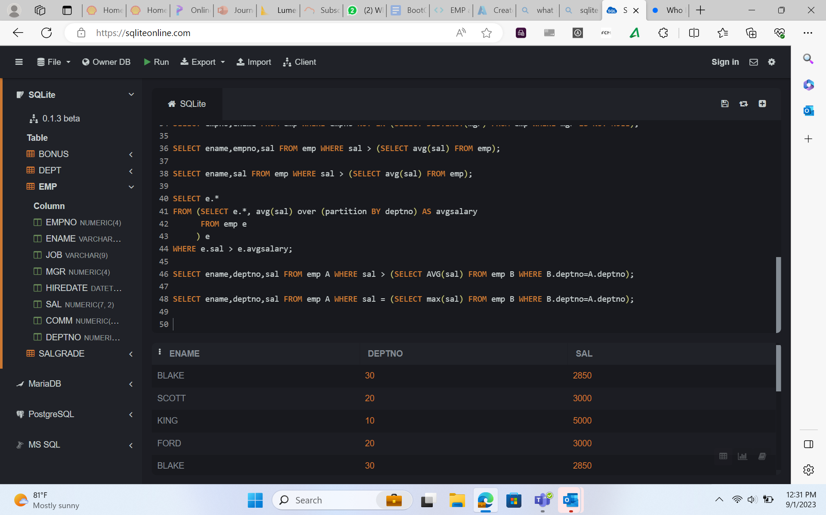
Journey PPT
(week 3)
Week-3 Day-5(1/09/2023)
Case study

Slide 15
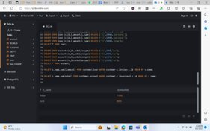
Journey PPT
(week 3)
Week-3 Day-5(1/09/2023)
Case study

Slide 16
Journey PPT
(week 3)
Week-3 Day-1(4/09/2023)
Azure storage type day-1
*Introduction to Azure storage in Microsoft Azure portal
*Azure storage redundancy option
*Azure blob storage
*Data Lake Gen2 Storage
*Container concept, File share, Queue and tables
*Create data lake gen2 and manage it
*Compare Data Lake Storage Gen2 and Azure Blob Storage

Slide 17
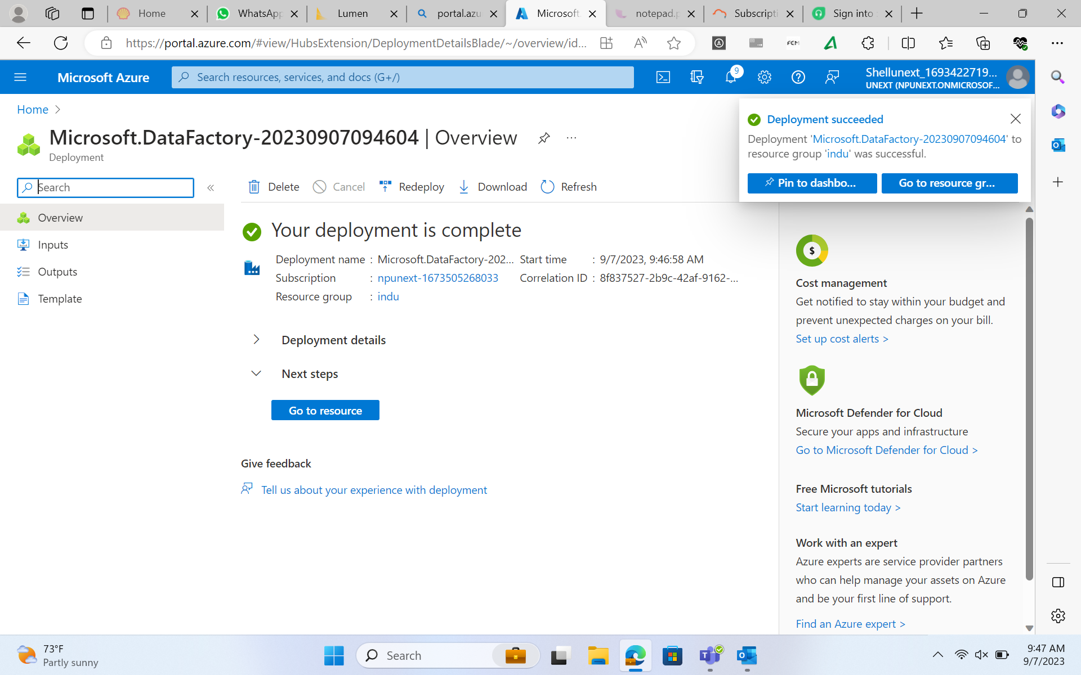
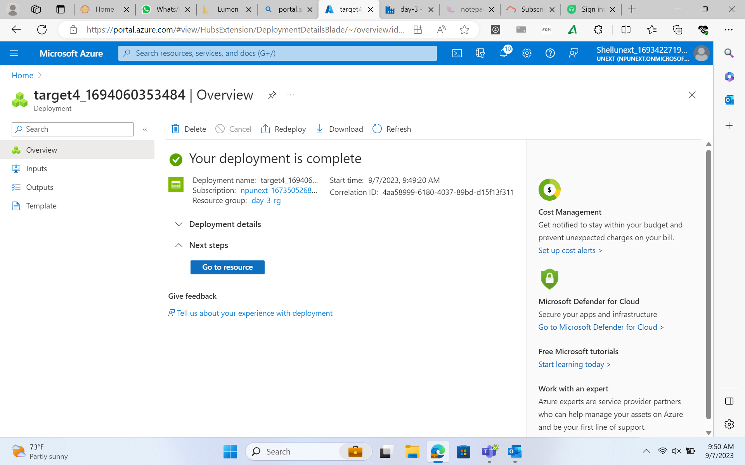
Journey PPT
(week 3)

Slide 18
Journey PPT
(week 3)
Week-3 Day-2(5/09/2023)
Azure storage type day-2
*Access and authentication
*Secure Access to Azure Storage
* upload data into data lake gen2
*Azure Data Factory introduction
*ELT vs ETL
*Dataset , Integration run time
*parameters, system variables
*Pipeline, pipeline chaining

Slide 19
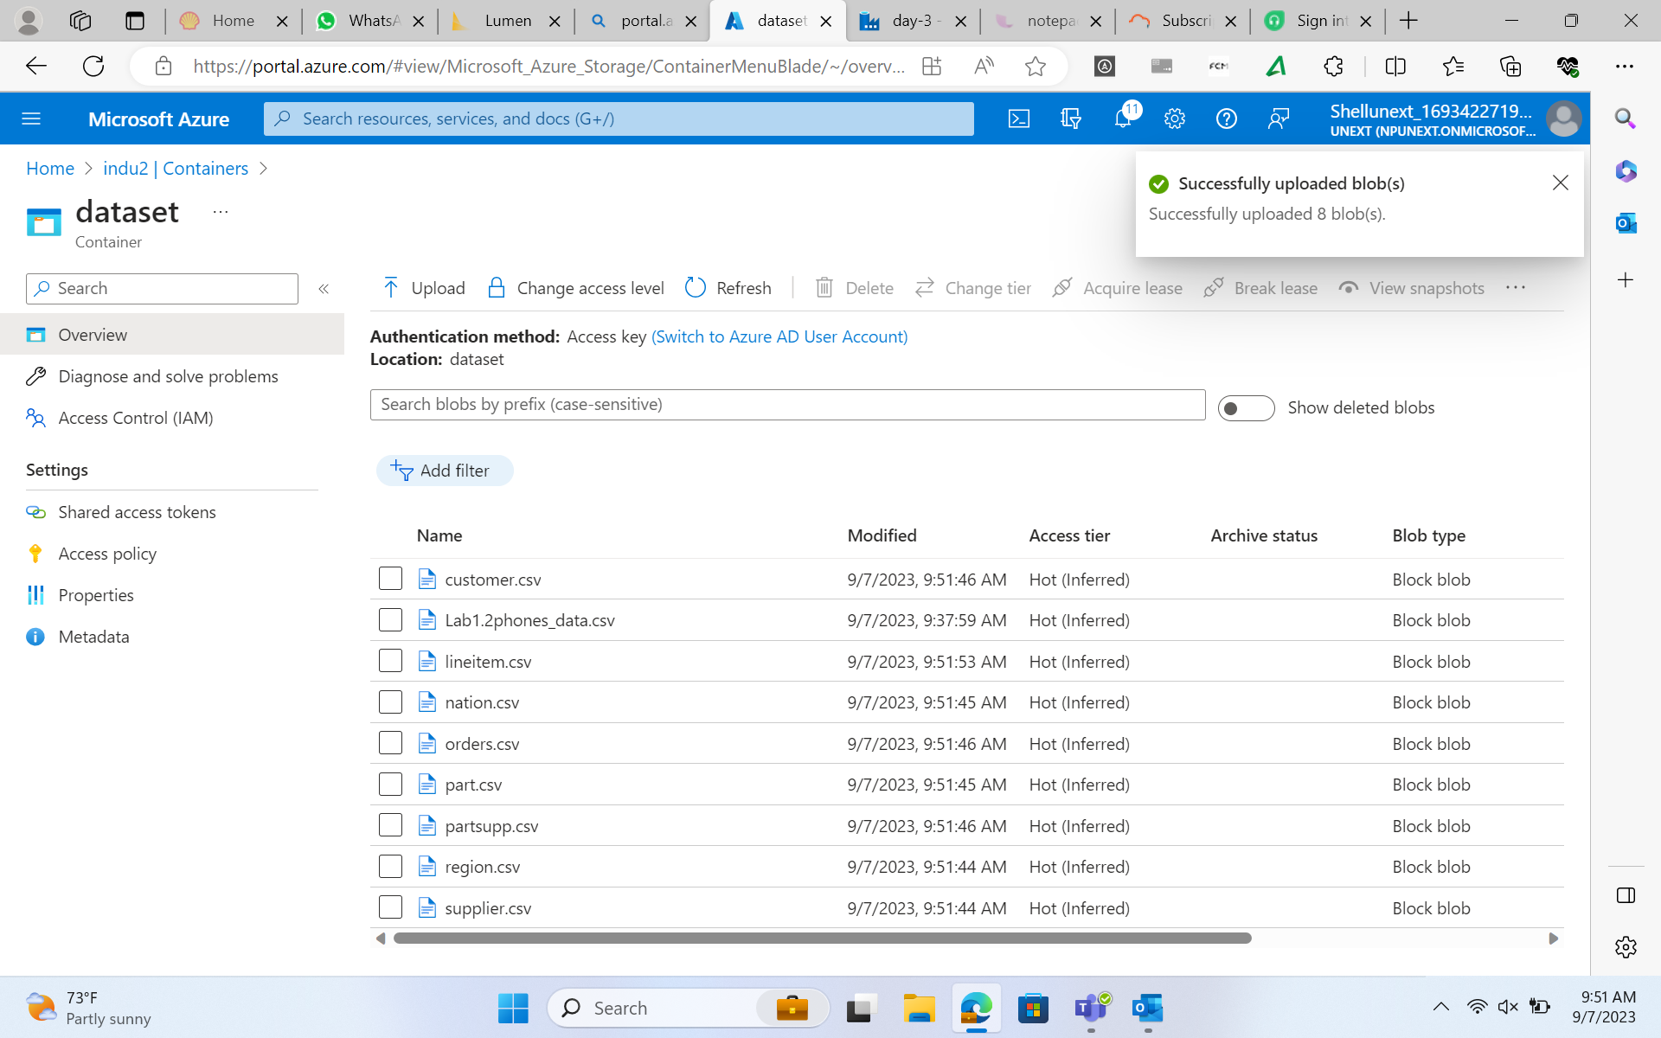
Journey PPT
(week 3)

Slide 20
Journey PPT
(week 3)
Week-3 Day-3(6/09/2023)
Azure Data Factory Day-1
*ADF components
*Copy Data Flow activity in ADF
*Linked services, Input & Output Data Set in ADF
*Control Flow Activity
*Get Metadata Activity
*Filter and If Activity
*Wait and foreach loop activity

Slide 21
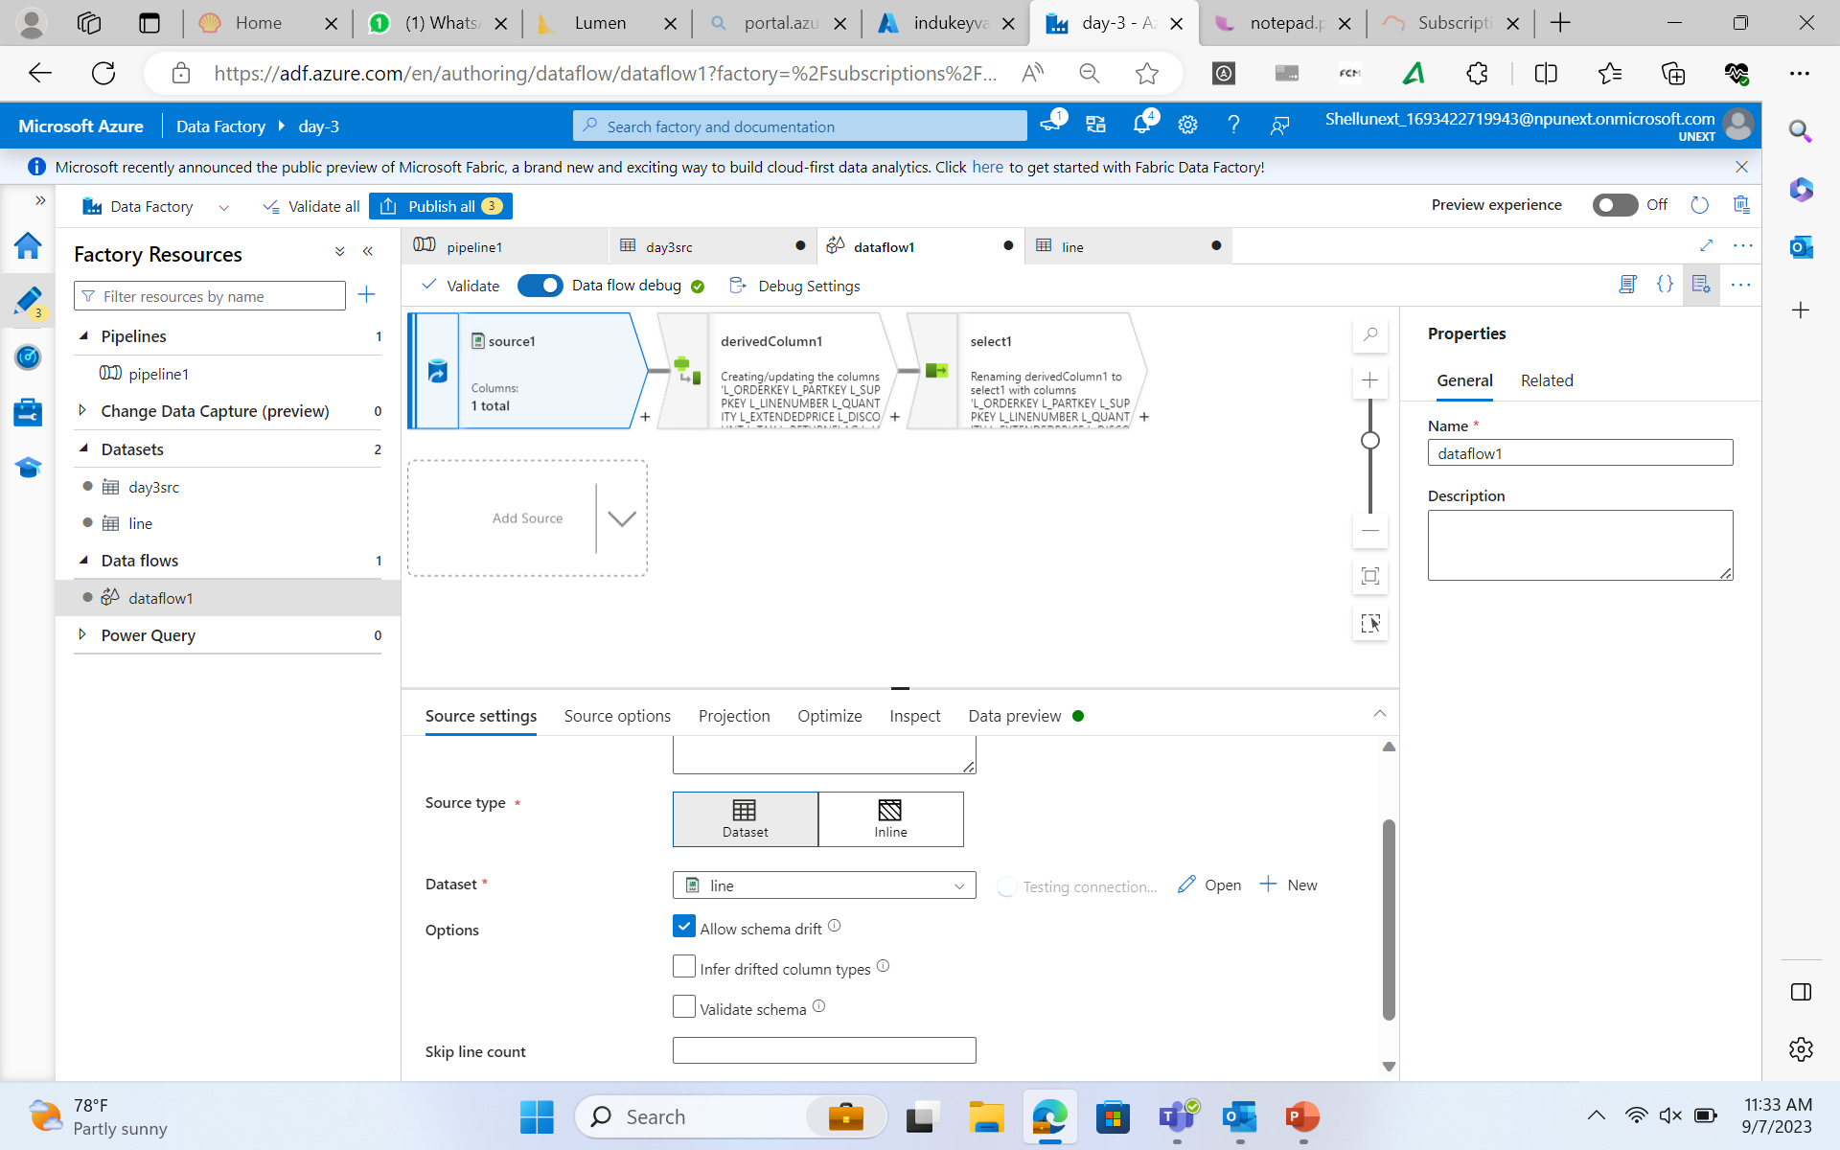
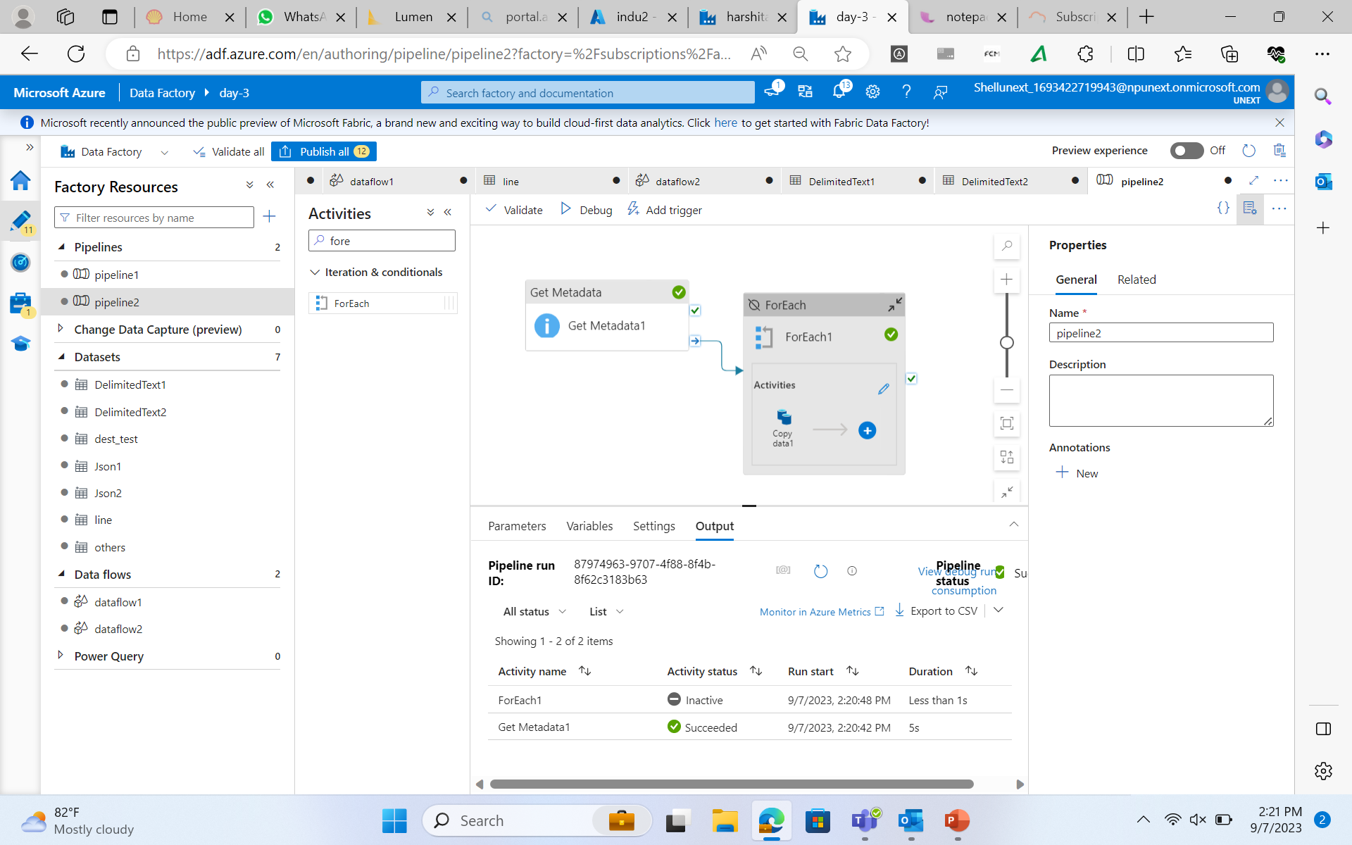
Journey PPT
(week 3)

Slide 22
Journey PPT
(week 3)
Week-3 Day-4(7/09/2023)
Azure Data Factory Day-2
*Mapping Dataflow Transformation ,source transformation, sink transformation, surrogate key transformation
*Conditional split transformation, Derived column transformation
*API- based Integration : Understanding
*Exploring the API – based Integration
*Introduction to CDC
*Understanding CDC in context of database and system
*Use cases for CDC and its benefits in integration scenarios.

Slide 23
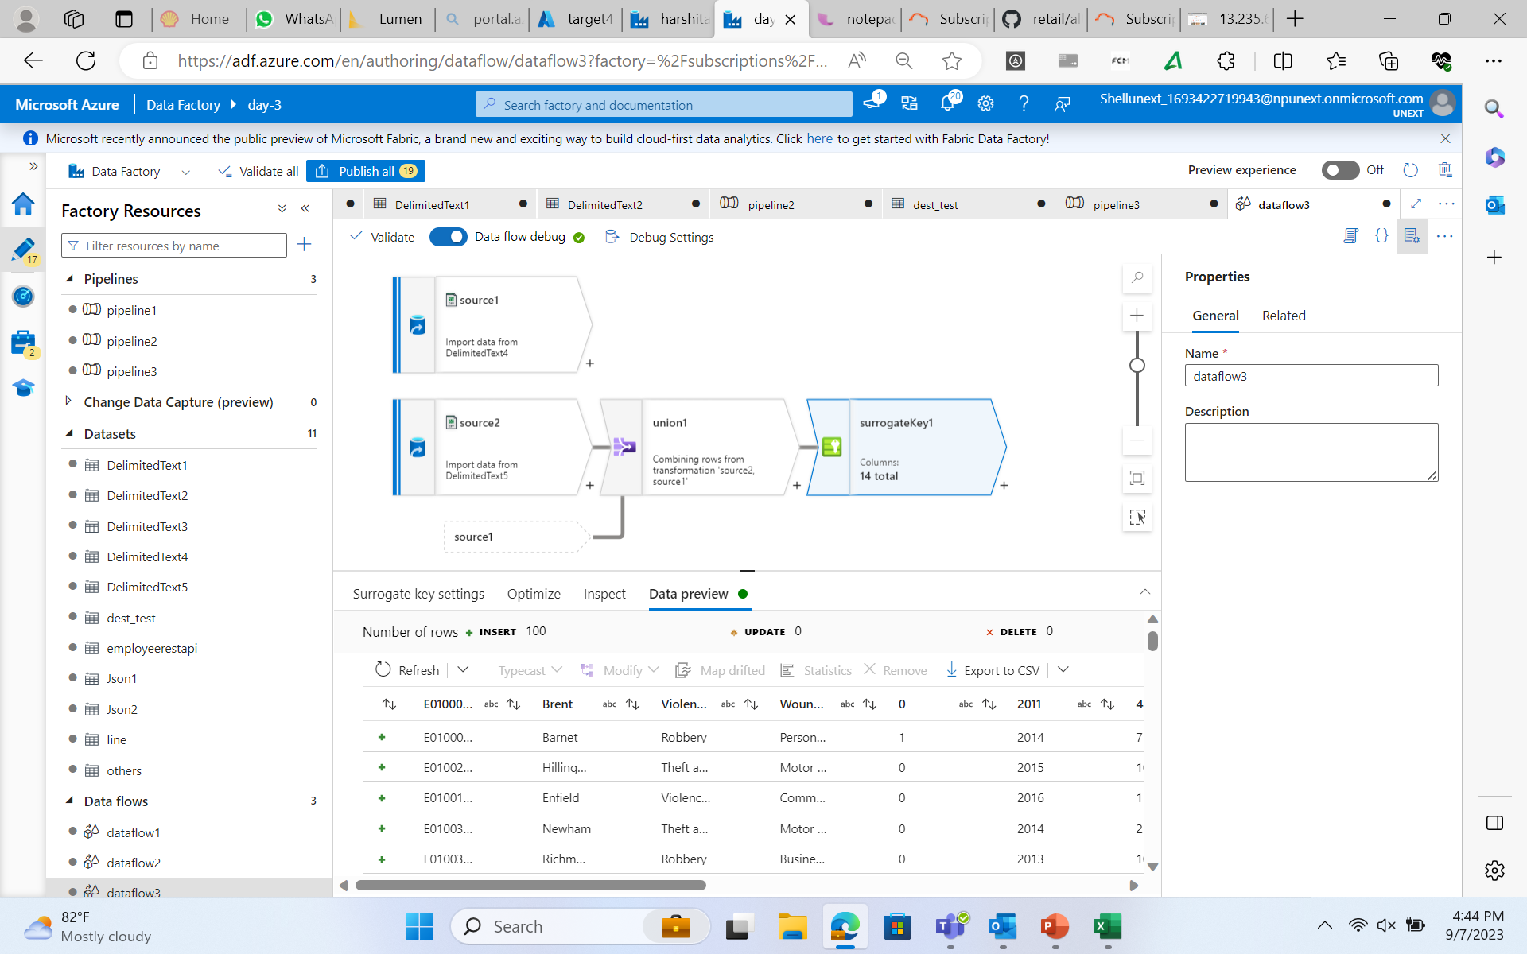
Journey PPT
(week 3)

Slide 24
Journey PPT
(week 3)
Week-3 Day-5(8/09/2023)
Azure Data Factory Day-3
*Hands-on on sql database creation
*loading the tables into the storage account
*Creation of pipeline for sql database
*Fetching, updating rows of a table and getting affected in adf and datastorage
*Creating the dataflow and cdc for the instances
*Debugging and triggering the dataflow and cdc
*Repitation of whole one week concepts
*Creating the automation account

Slide 25
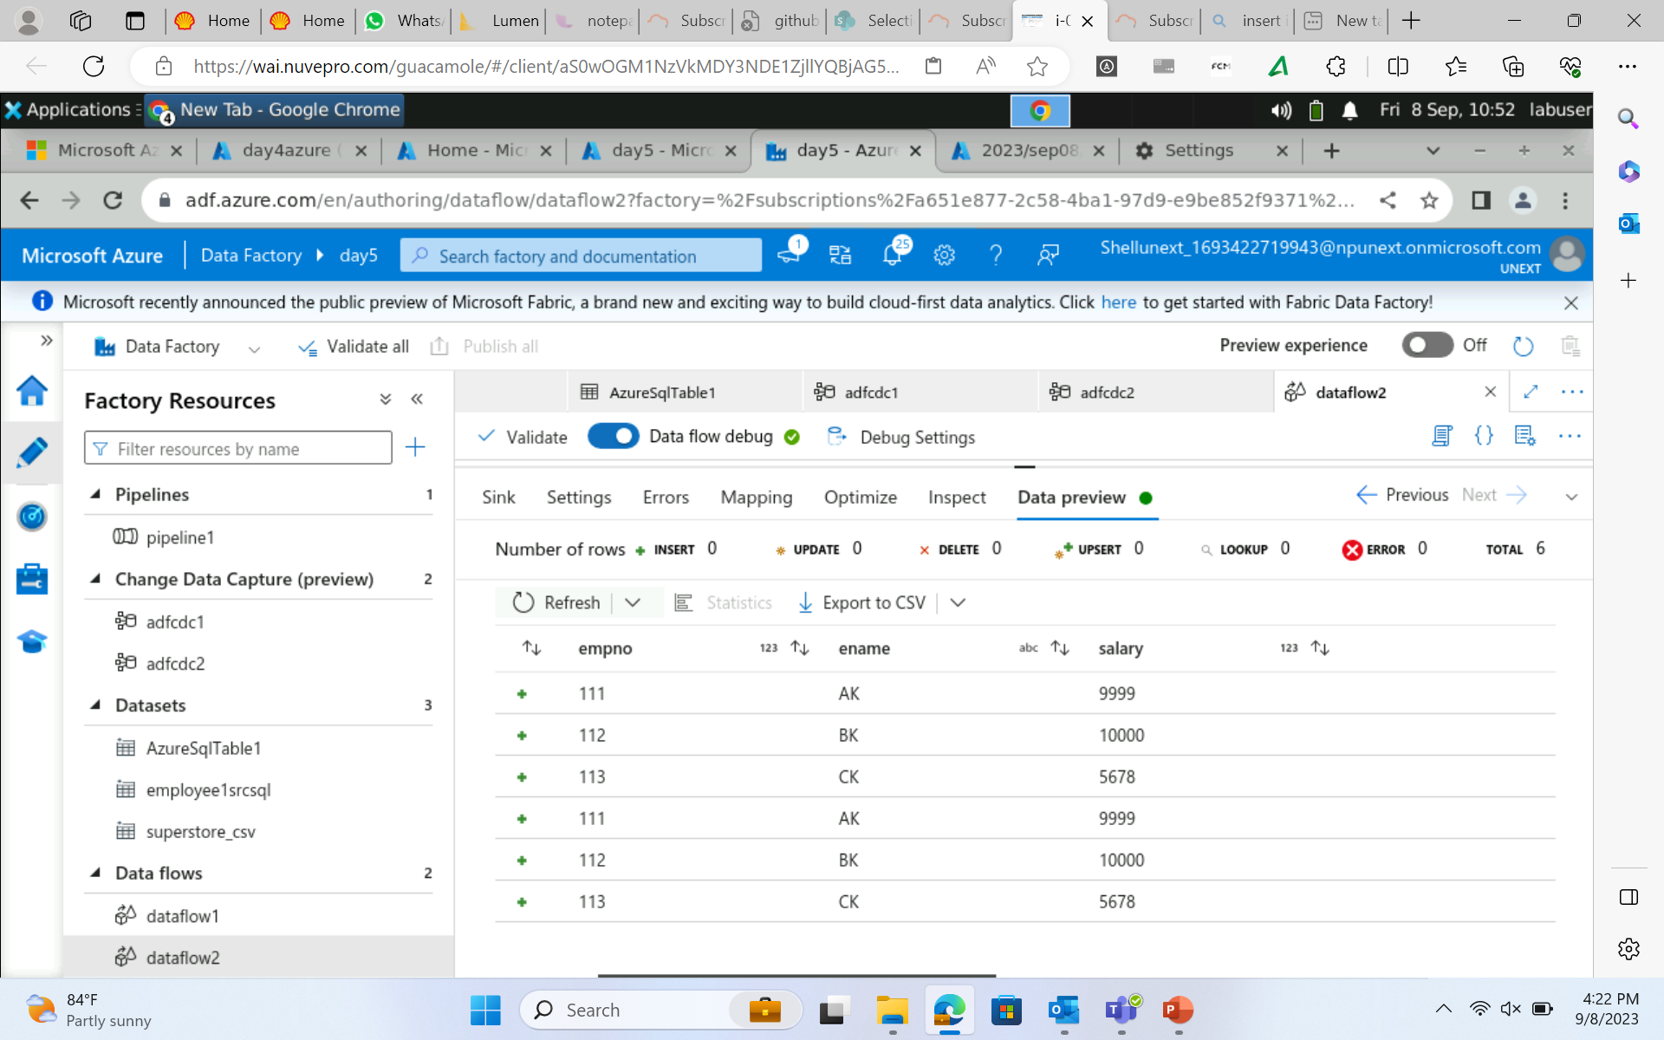
Journey PPT
(week 3)

Slide 26
Journey PPT
(week 4)
Week-4 Day-1(11/09/2023)
Doubt Solving session
*Repitation of Azure Data Factory
*Hands-on on Azure Data Factory
*loading the dataset into the storage account
*Creation of pipeline
*Fetching, updating rows of a table and getting affected in adf and datastorage
*Creating the dataflow and cdc for the instances
*Debugging and triggering the dataflow and cdc

Slide 27
Journey PPT
(week 4)
Week-4 Day-2(12/09/2023)
Azure Synapse Analytics
*Introduction to Azure Synapse Analytics
*Mapping of data flow
*Creation of pipeline, Data Ingestion and Preparation
*Write and execute SQL queries
*Understanding query performance optimization technique
*Exploring the more options like manage, linked device creation
*Explanation with theory and practical for all of the above concept

Slide 28
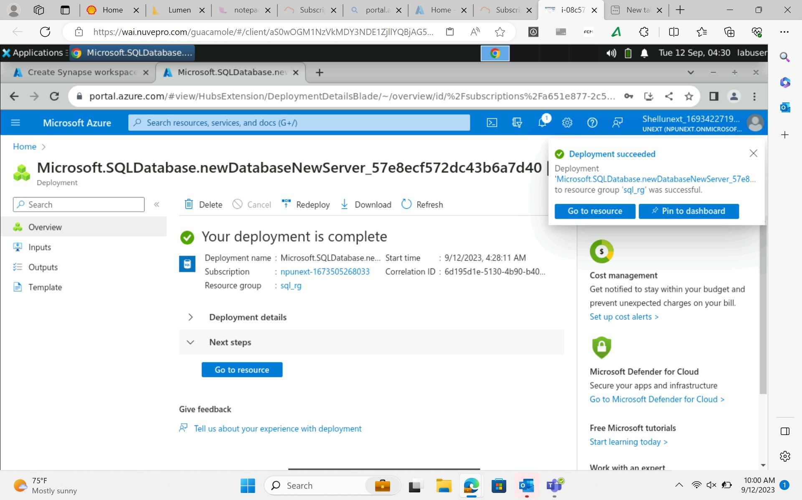
Journey PPT
(week 4)

Slide 29
Journey PPT
(week 4)
Week-4 Day-3(13/09/2023) day-1
Data Visualization using Power-Bi
*Understanding and exploring about Power-Bi
*Connecting to the various sources
*Data load and transformation- removing duplicates, add column, slicers and group
*Introduction to Dax and calculated column
*Implicit and explicit measures
*Row level security and aggregation function
*Explanation with theory and practical for all of the above concept

Slide 30
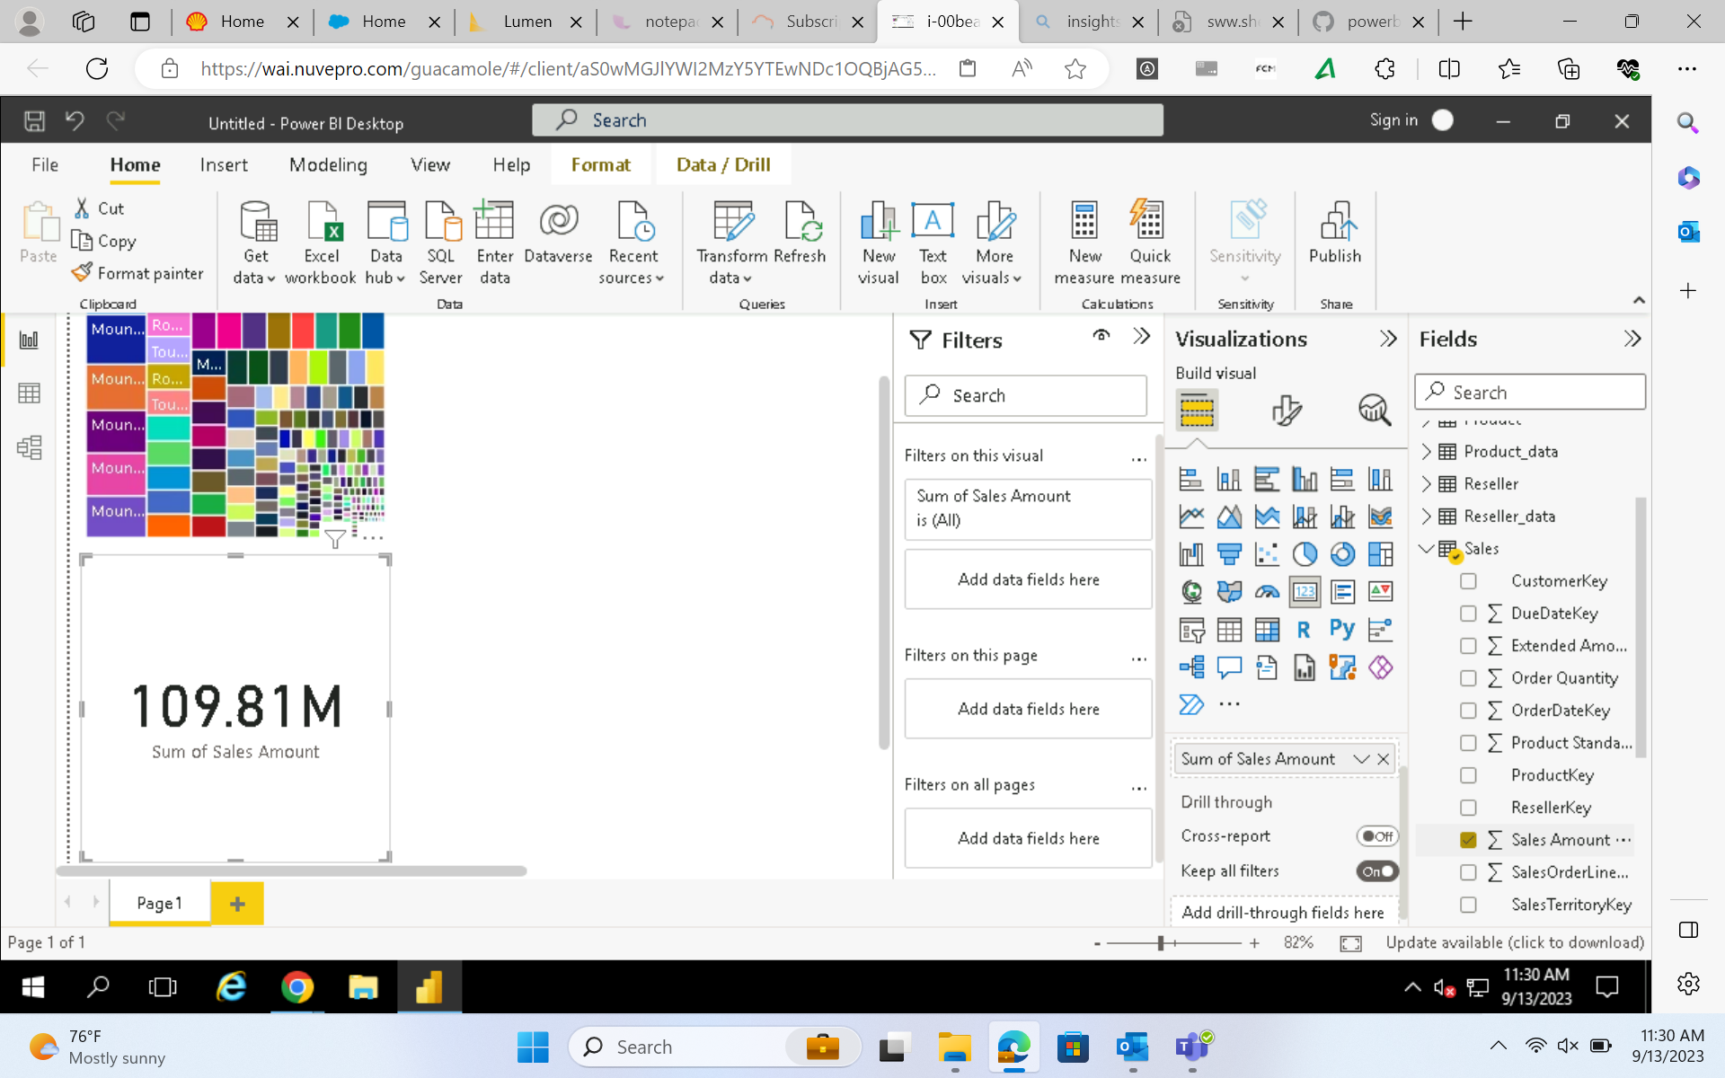
Journey PPT
(week 4)

Slide 31
Journey PPT
(week 4)
Week-4 Day-4(14/09/2023)
Data Visualization using Power-Bi day-2
*Understanding various chart-type
*Report and models
*Dashboard
*Hands-on
*Recap
*Scenario based chart preparation
*Pushing that into Git-hub account

Slide 32
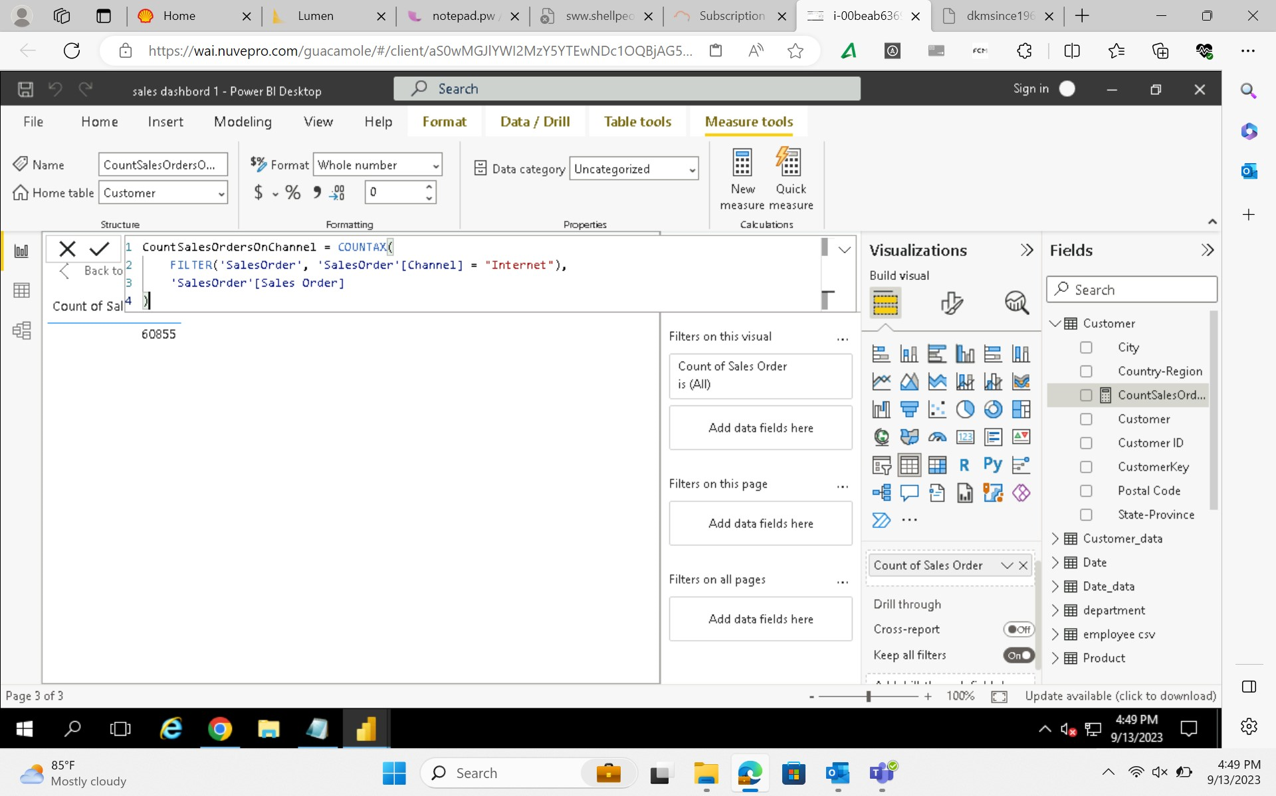
Journey PPT
(week 4)

Slide 33
Journey PPT
(week 4)
Week-4 Day-5(15/09/2023)
*hand-son assessment on Power BI
Python Day-1
*Understanding Python with various salient characters
*Understanding datatypes and operators with scenario
*String formatting and type casting
*Counter(), zip() and enumerate functions
*Conditional statement (if-else)
*User-defined functions
*Hands-on
*Executing the code inside the Jupyter Notebook

Slide 34
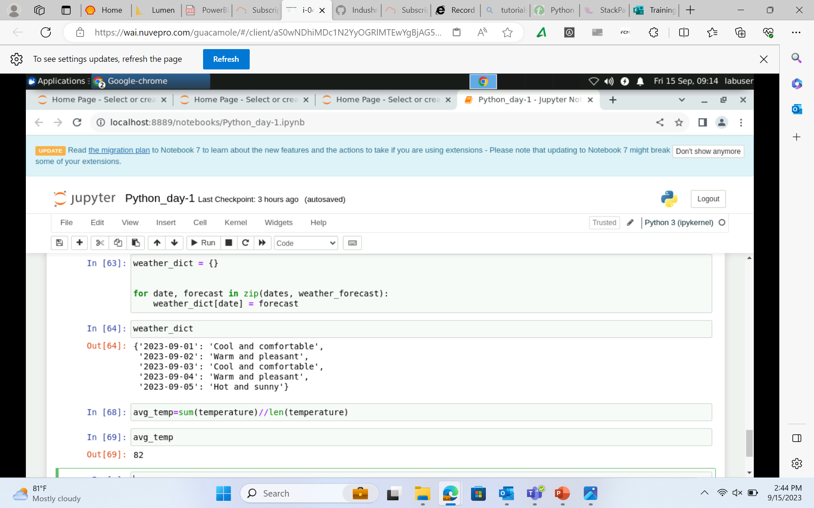
Journey PPT
(week 4)

Slide 35
Journey PPT
(week 5)
Week-5 Day-1(19/09/2023)
Python Day-2
*Advanced: Functions
**args and *kwargs
*Positional and Keyword arguments
*Classes
*List Comprehension
*Lambda Functions

Slide 36
Journey PPT
(week 5)
Week-5 Day-2(20/09/2023)
Python Day-3
*Introduction to Panda Data Frame, series
*Lists, Numpy Array
*Dictionaries
*Sets
*Tuples
*Map
*NumPy and Pandas
*Matplotlib and SciPy
*Scikit-learn

Slide 37

Journey PPT
(week 5)

Slide 38
Journey PPT
(week 5)
Week-5 Day-3(21/09/2023)
PySpark day-1
*Introduction, Overview and Installation
*Components of Spark and Spark Architecture
*Job Lifecycle and Application of Spark
*Apache Spark use cases
*Introduction to PySpark Shell
*Submitting PySpark Job
*RDD concepts overview
*Common Transformation and actions

Slide 39
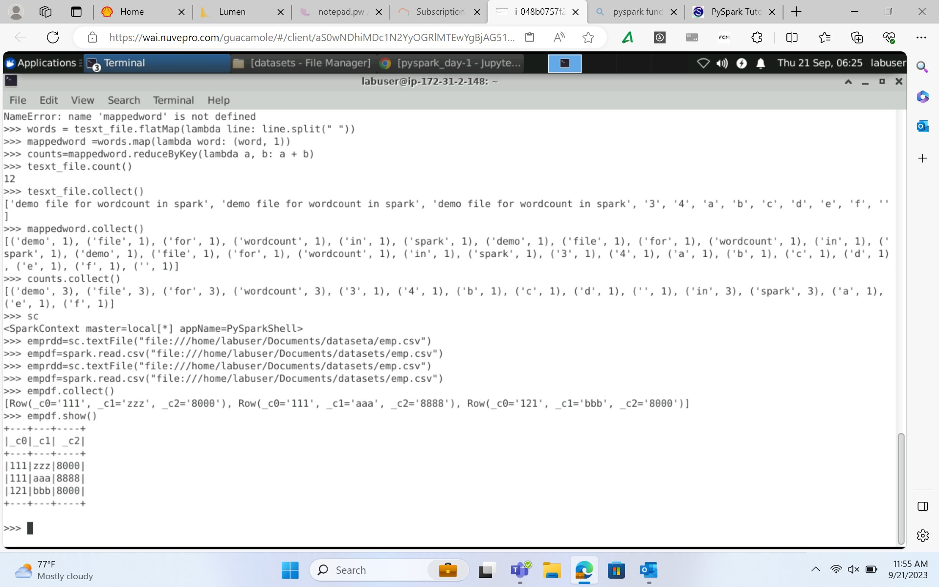
Journey PPT
(week 5)

Slide 40
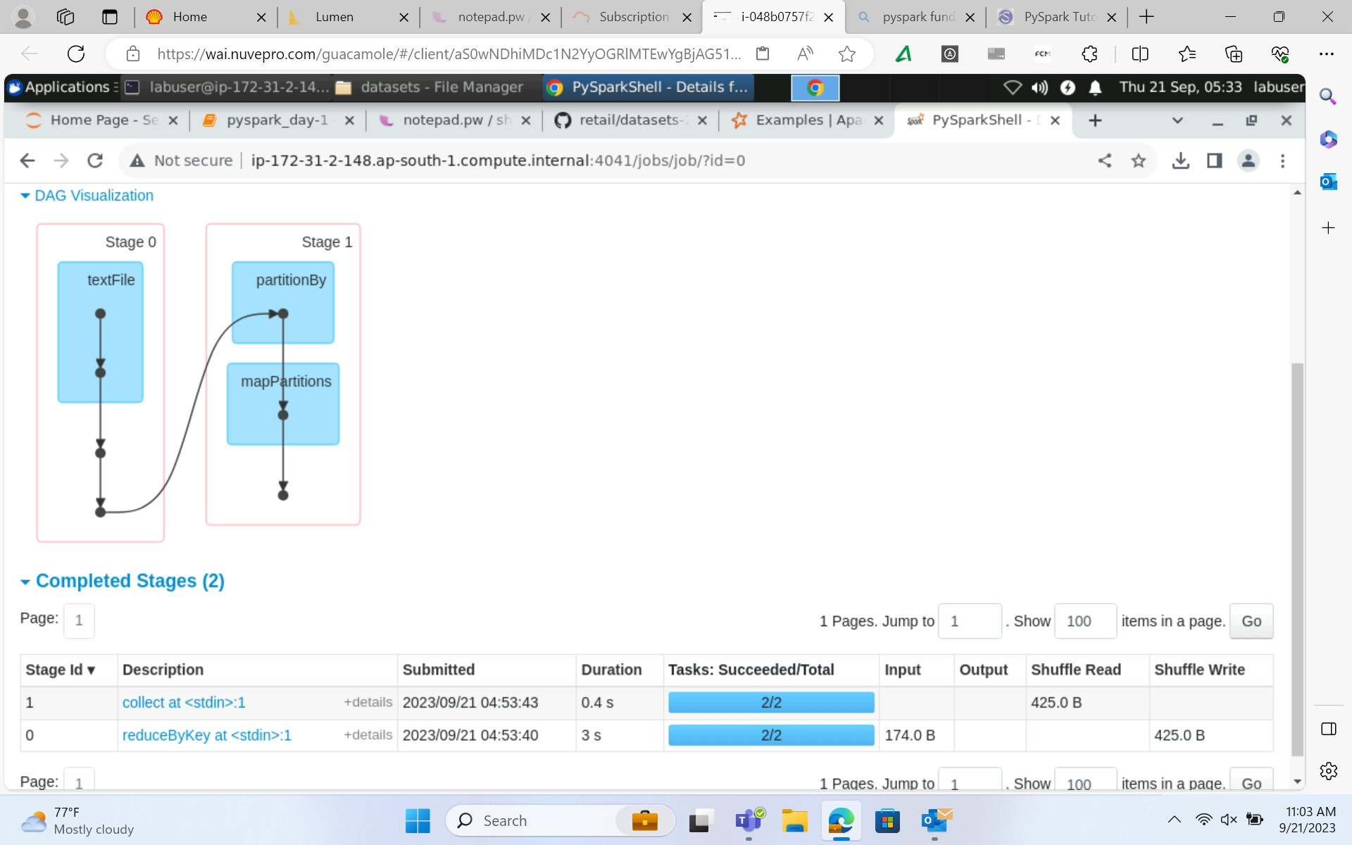
Journey PPT
(week 5)

Slide 41
Journey PPT
(week 5)
Week-5 Day-4(22/09/2023)
PySpark day-2
*Joining and aggregation
*Filtering Dataframe
*Reading from data from given dataset
*Handling null values
*cleaning and transforming data
*Data cleaning

Slide 42
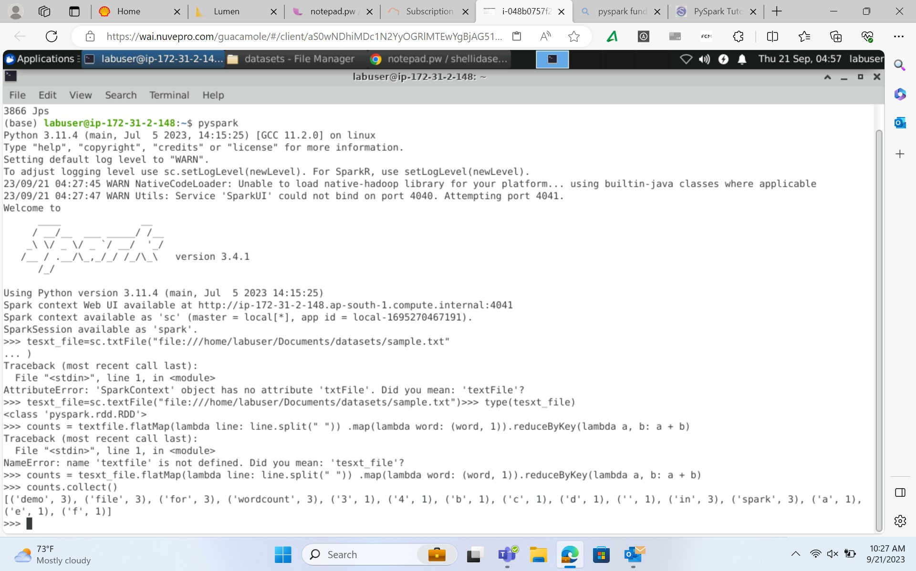
Journey PPT
(week 5)

Slide 43
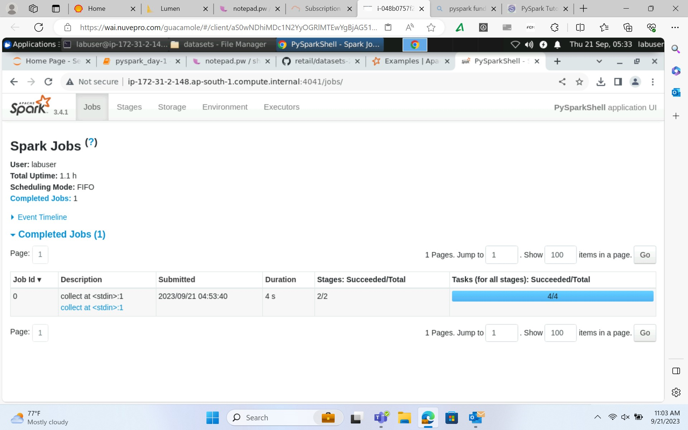
Journey PPT
(week 5)

Slide 44
Journey PPT
(week 6)
Week-6 Day-1(25/09/2023)
PySpark day-3
*Data cleaning and filtering
*Handling null-values
*Transforming data with example
*Reading data from given dataset(file/table)
*Clean and transform data
*Attended IDA people meeting in Sheraton Grand whitefield

Slide 45
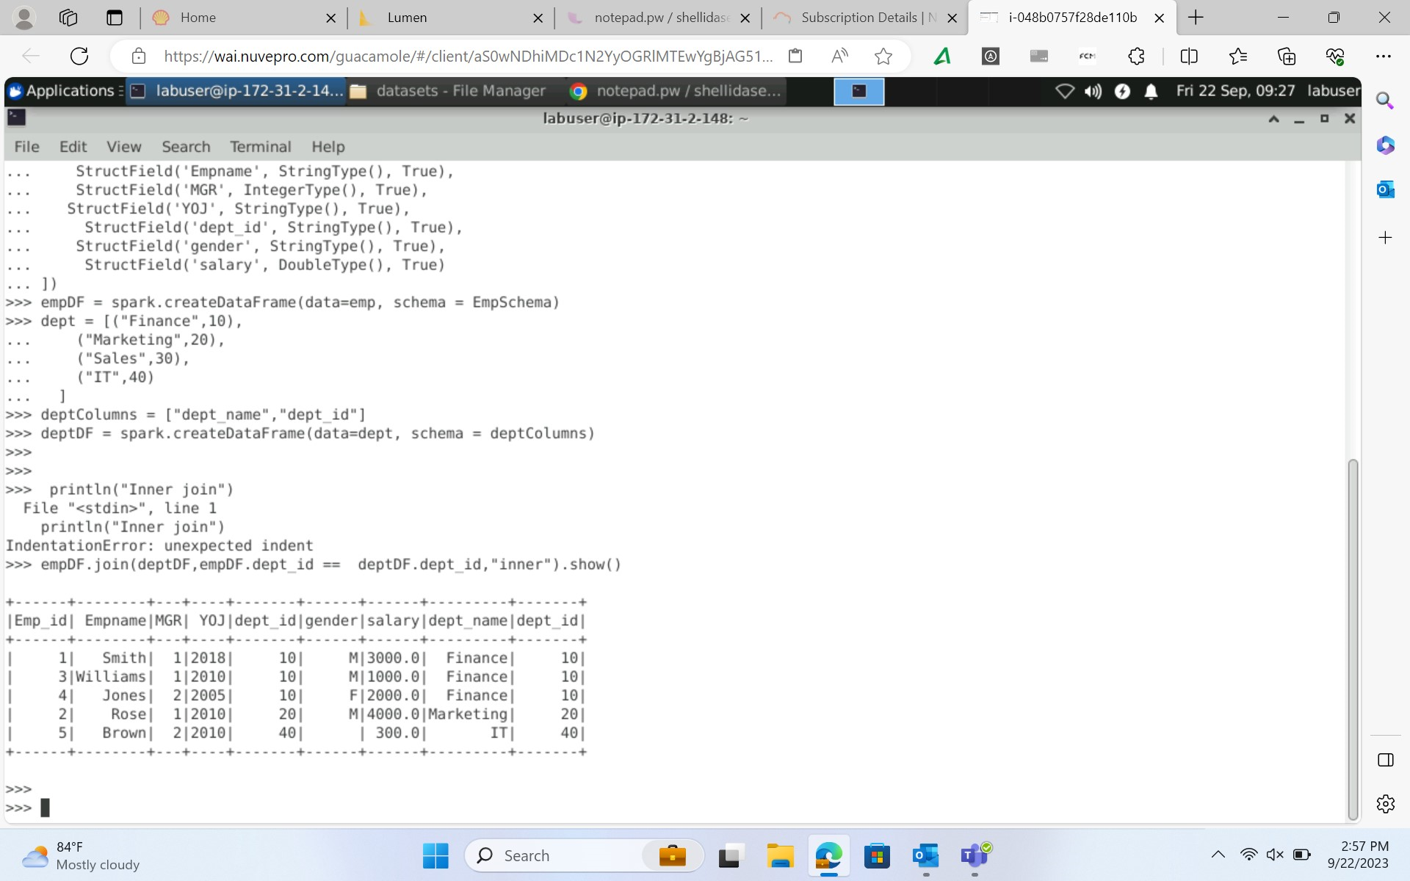
Journey PPT
(week 6)

Slide 46
Journey PPT
(week 6)
Week-6 Day-2(26/09/2023)
Databricks day-1
*Introduction to Databricks
*workspace creation, Notebook, Library and Repos
*Computation Management: cluster, pool
*Azure databricks using PySpark and Spark SQL
*Dataframes and DBFS in Azure Databricks
*Creating first Notebook and connect to datalake
*Read and write file to DataLake

Slide 47
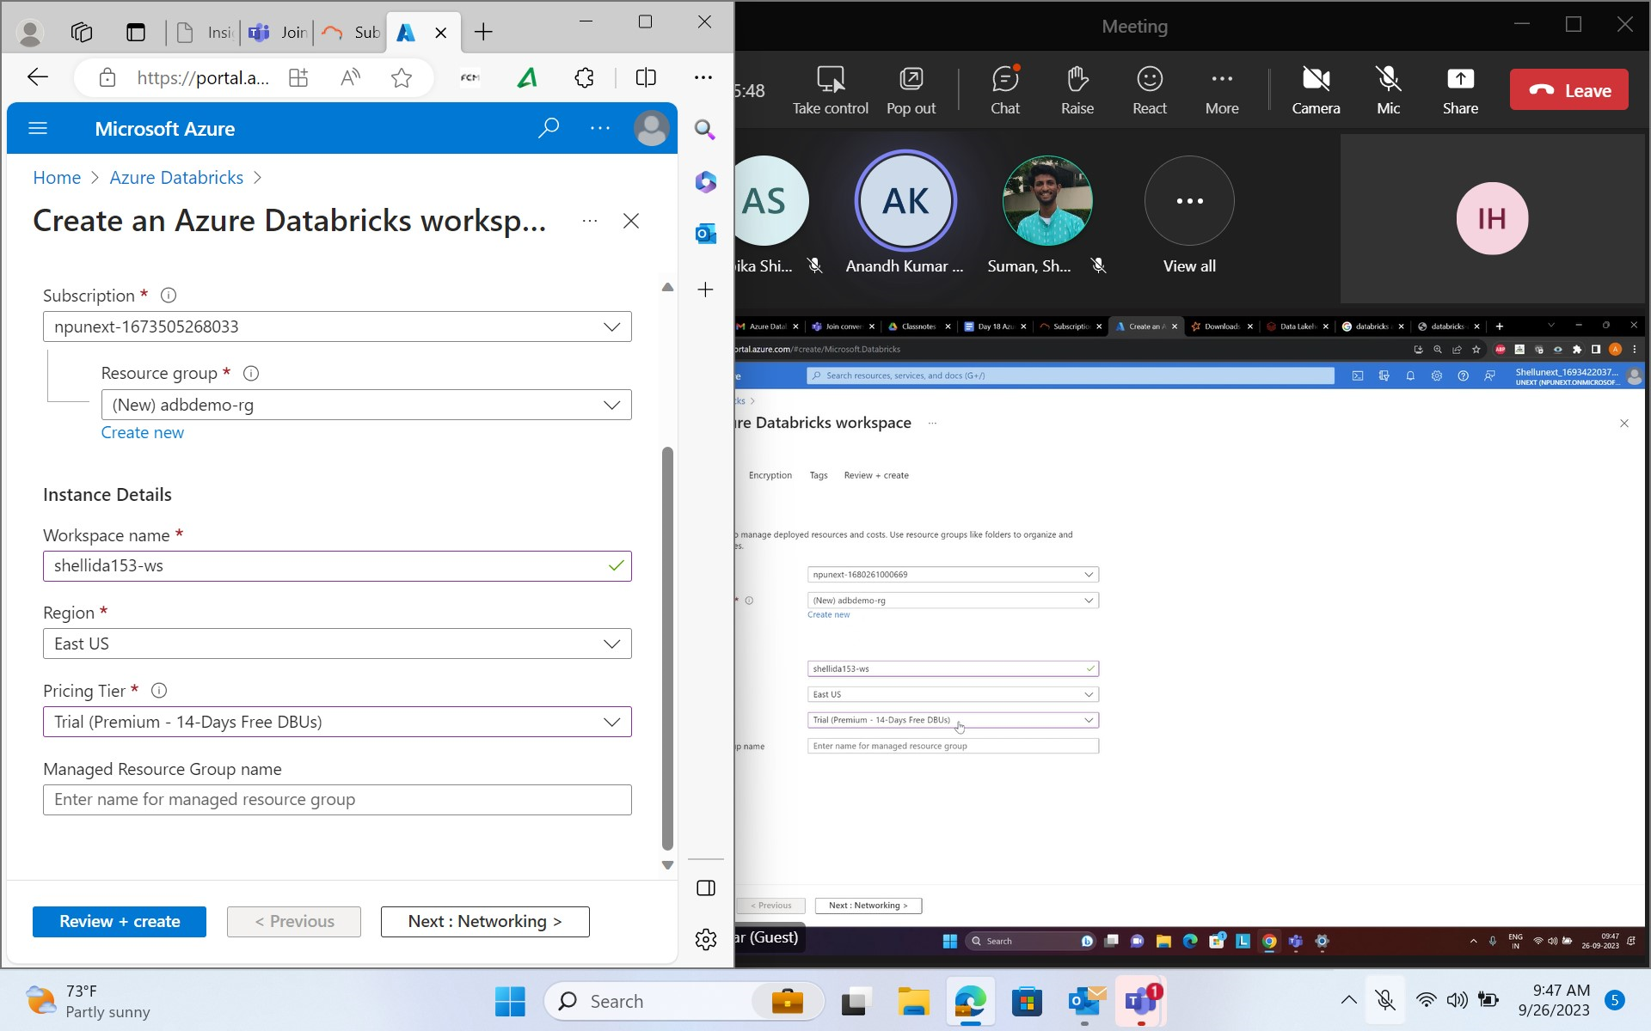
Journey PPT
(week 6)

Slide 48
Journey PPT
(week 6)
Week-6 Day-3(27/09/2023)
Databricks day-2
*Security and protection
*ADB Integration with other services(synapse, SQL DB, Power BI)
*Delta Lake concept and error handling
*Overview on Azure Databricks unity catalog
*Introduction and setting up Azure SQL Endpoint
*SQL Analytics for querying data within data platform

Slide 49
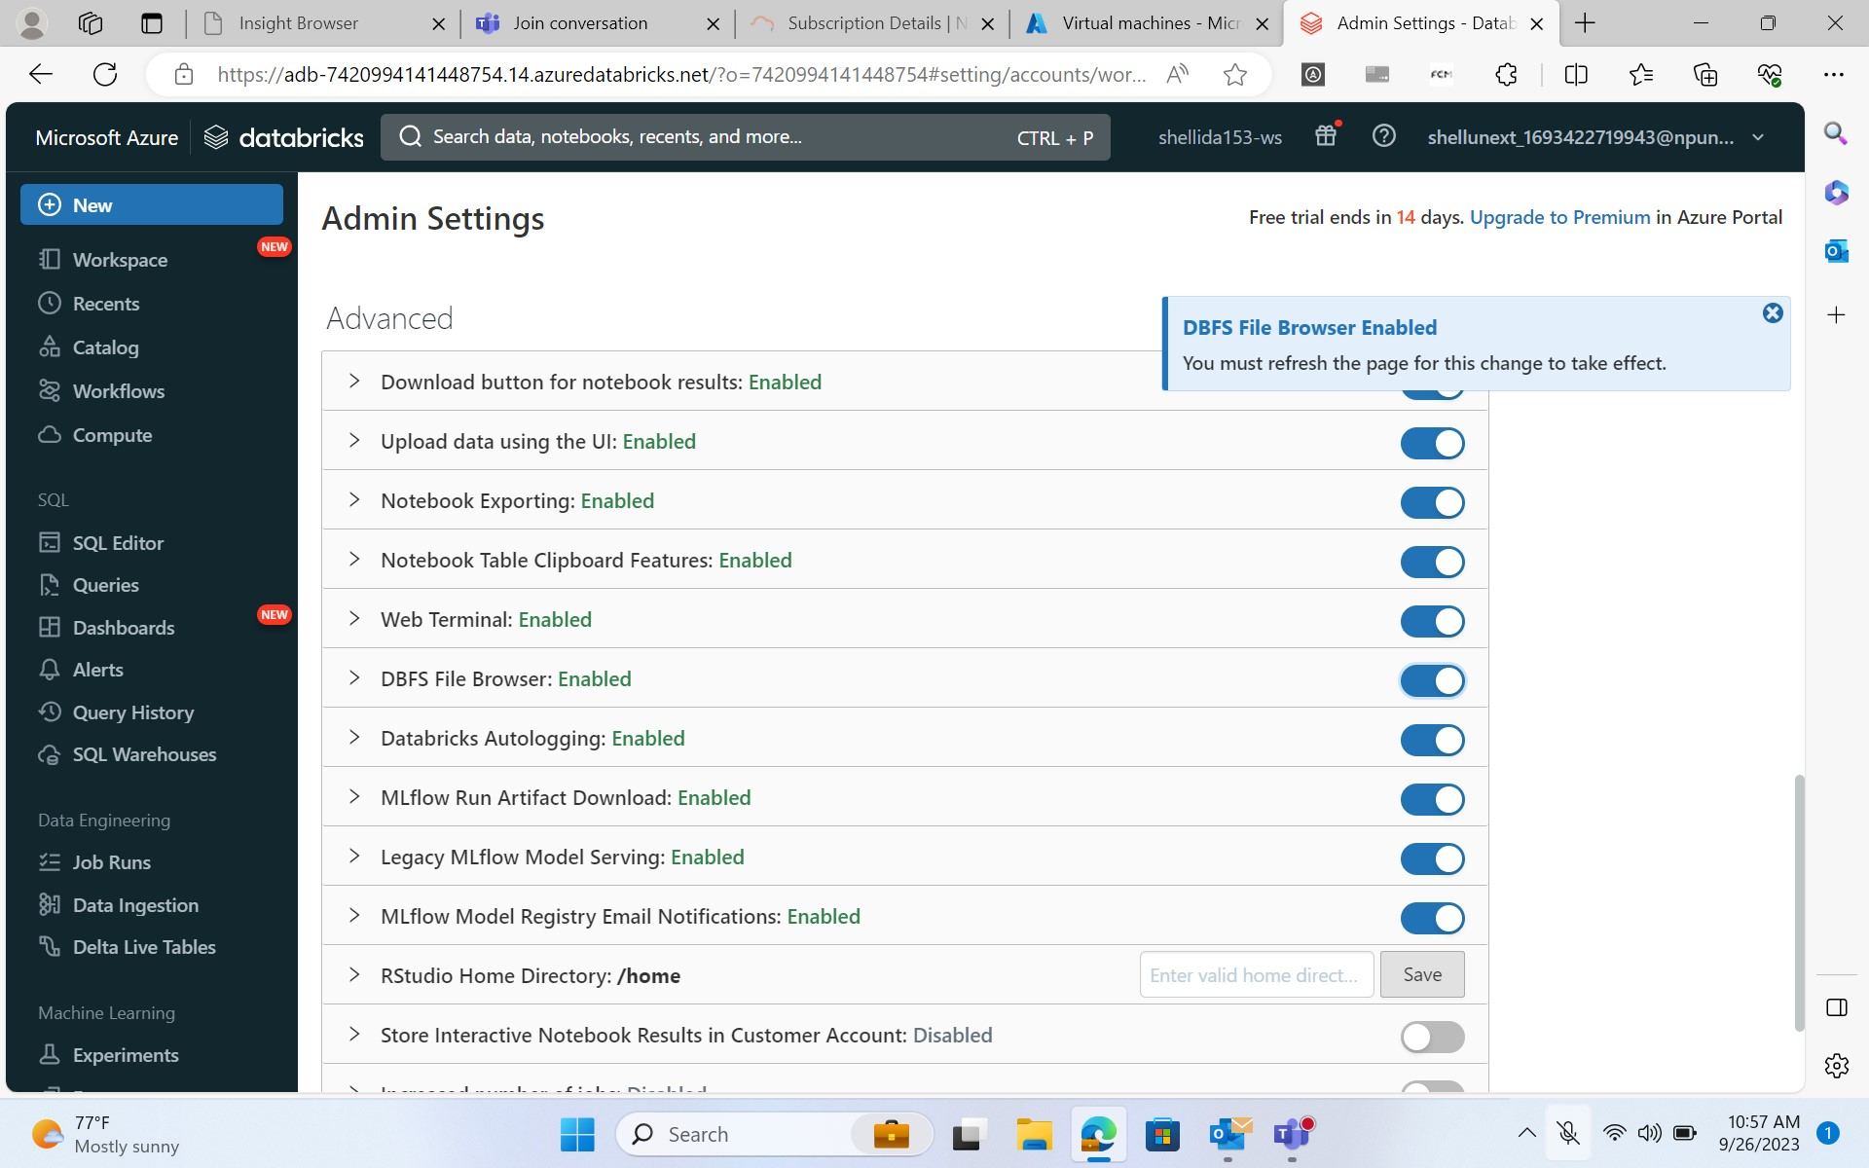
Journey PPT
(week 6)

Slide 50
Journey PPT
(week 6)
Week-6 Day-4(28/09/2023)
Azure Containers- Docker
*Security and protection
*ADB Integration with other services(synapse, SQL DB, Power BI)
*Delta Lake concept and error handling
*Overview on Azure Databricks unity catalog
*Introduction and setting up Azure SQL Endpoint
*SQL Analytics for querying data within data platform

Slide 51
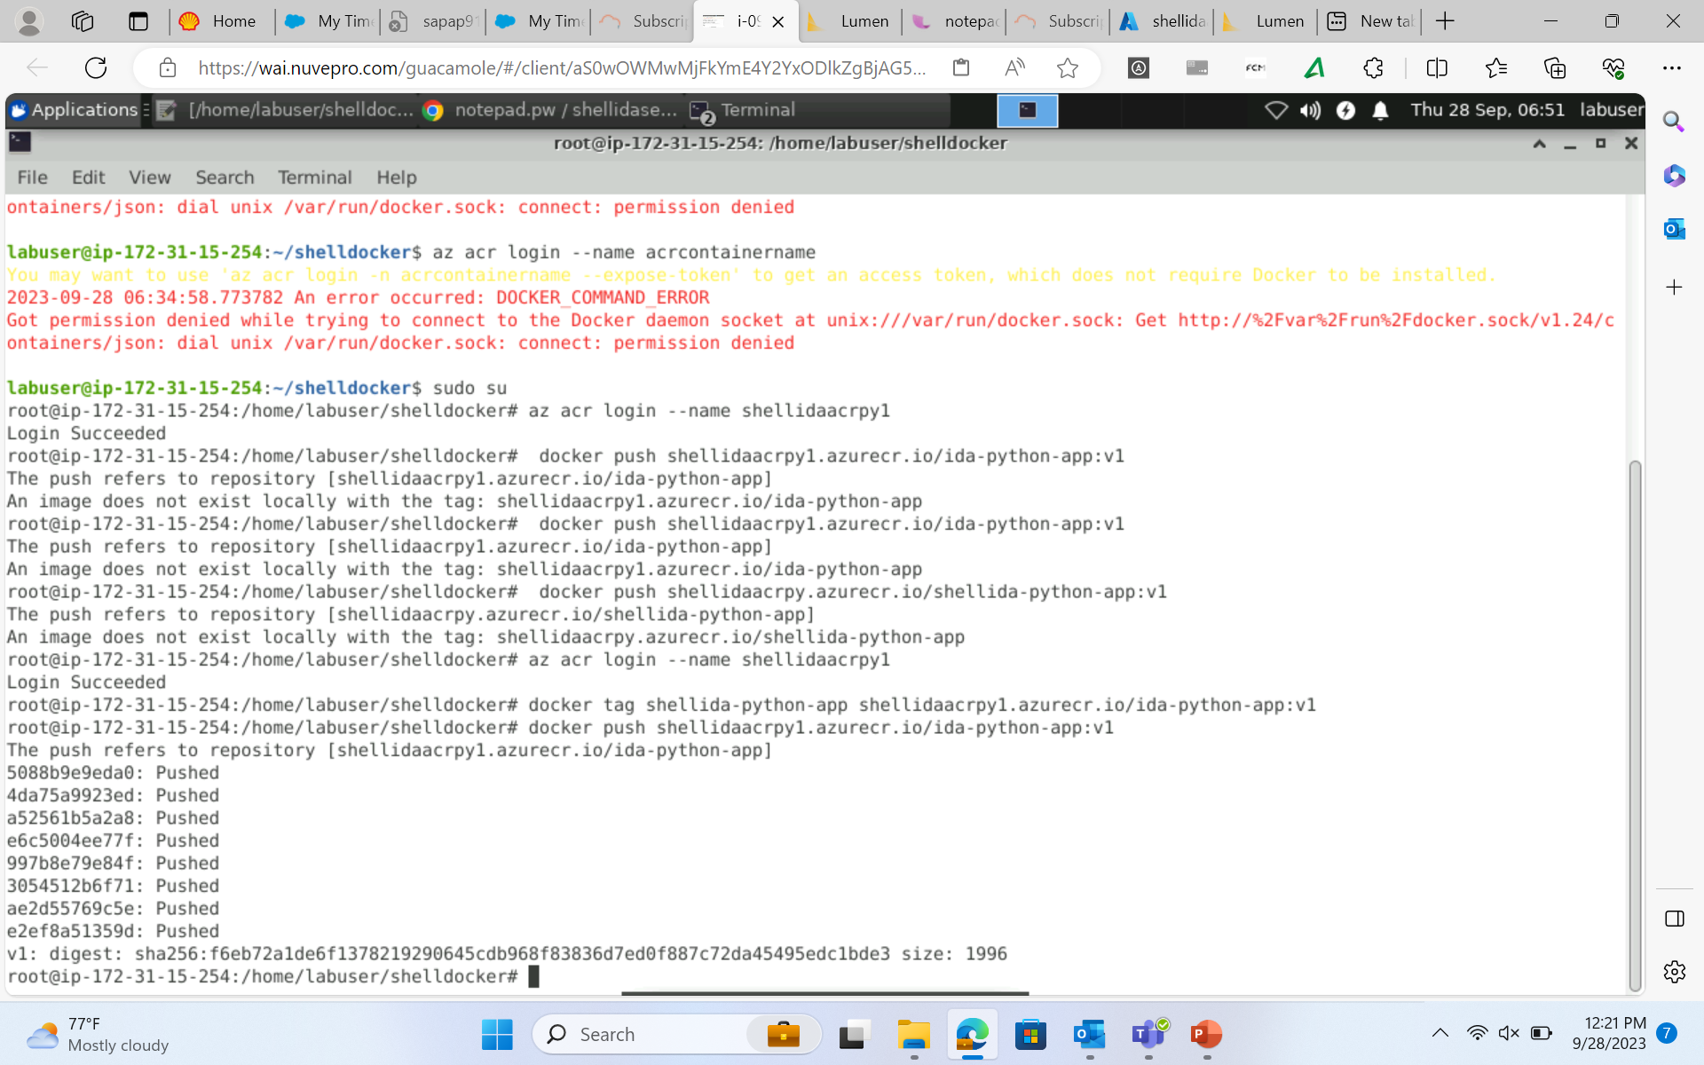
Journey PPT
(week 6)

Slide 52
Journey PPT
(week 6)
Week-6 Day-5(29/09/2023)
Azure DevOps
*Introduction to Azure Deployment
*Understanding and implementing DevOps practices
*Introduction to CI/CD
*Introduction to Git and GitHub
*GitHub as Azure platform
*GitHub actions and CI/CD
*GitHub repo and branching

Slide 53
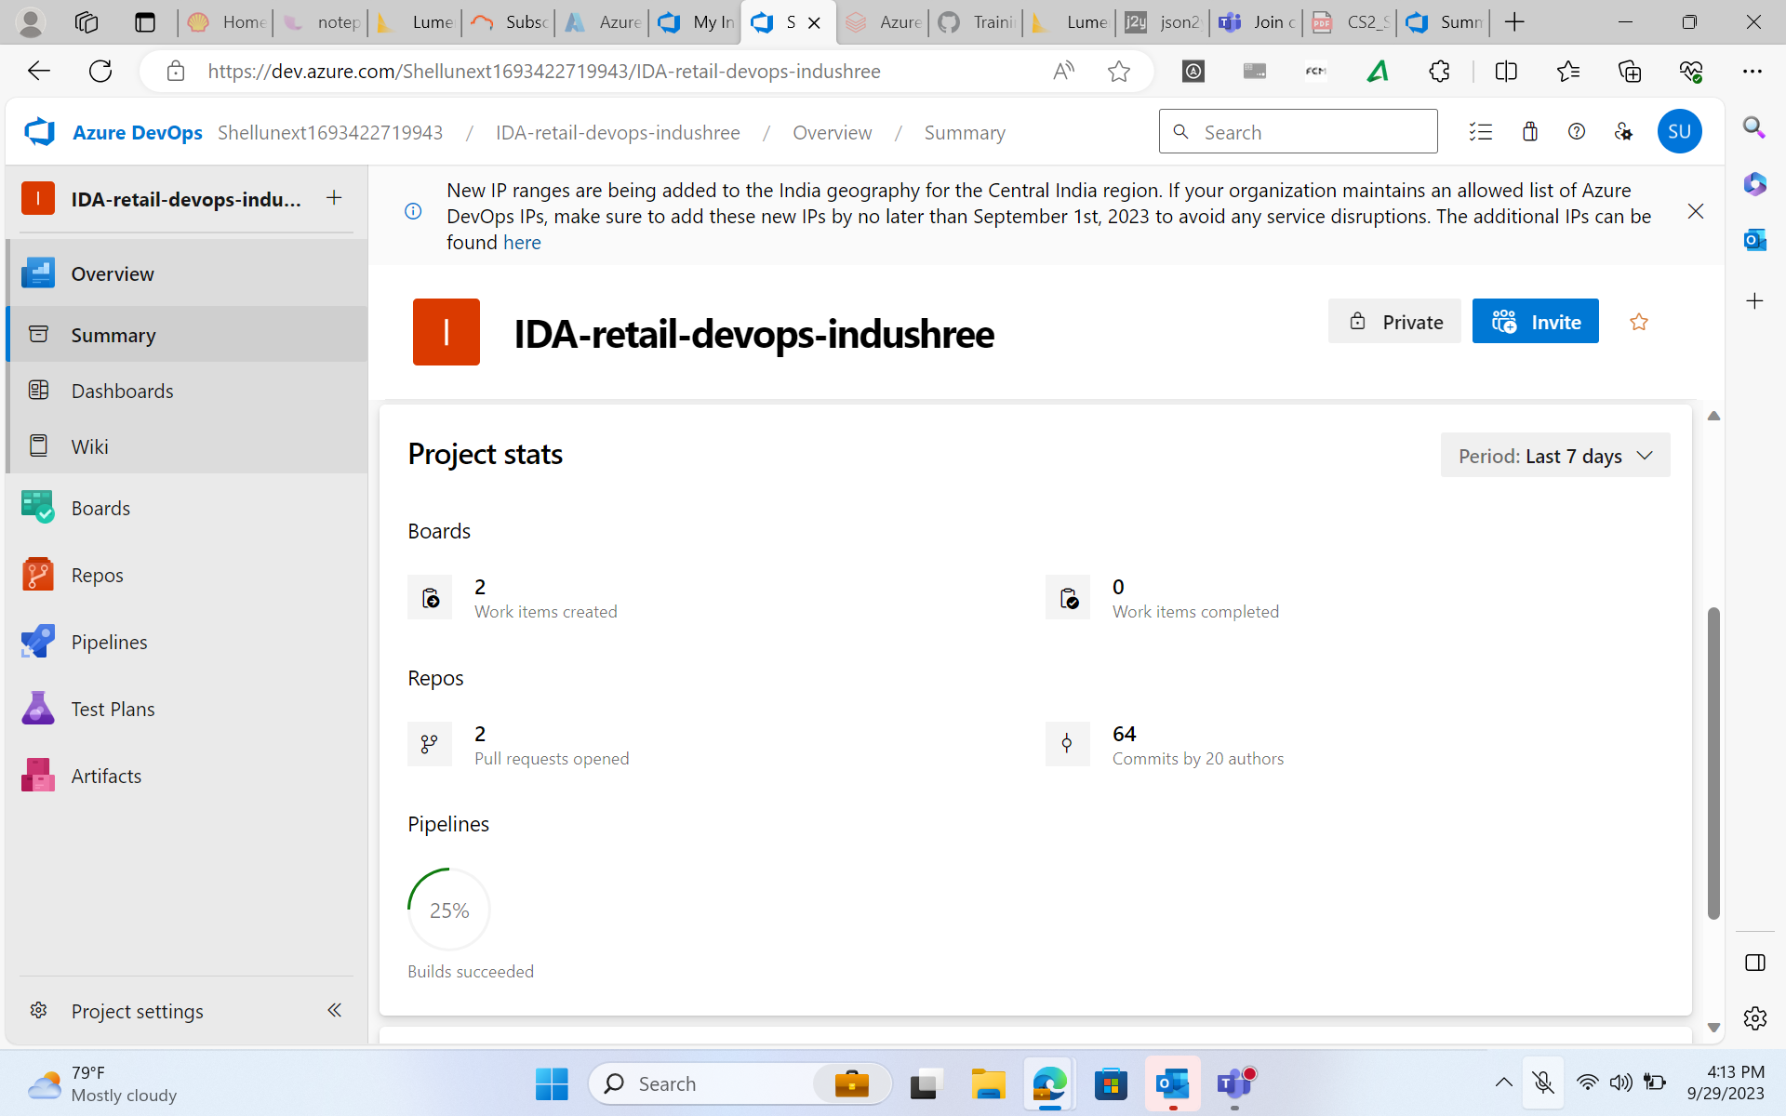
Journey PPT
(week 6)

Slide 54
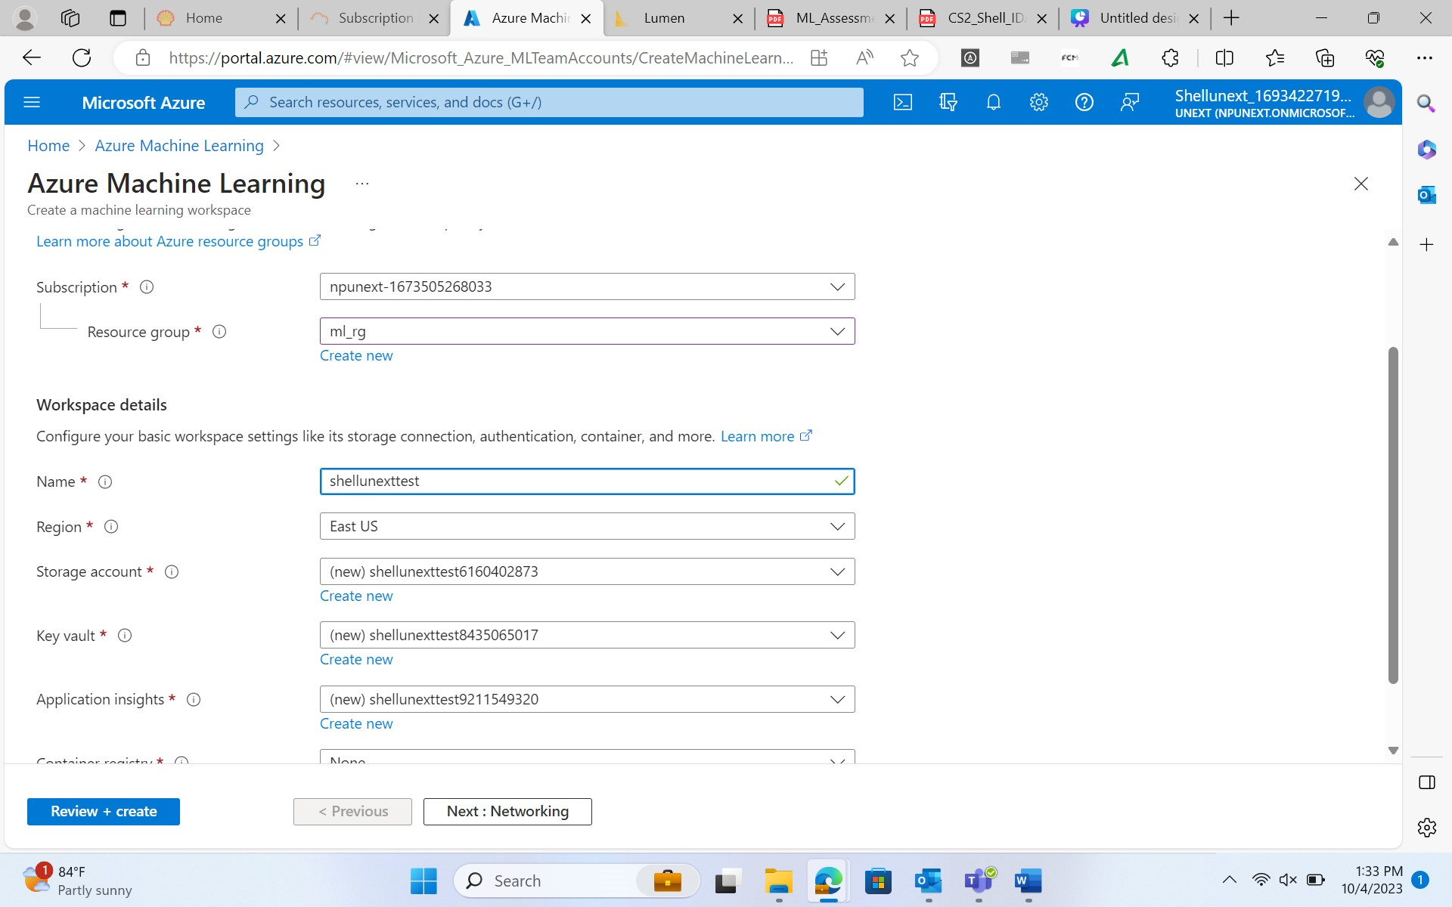
Journey PPT
(week 7) ML Studio Day-1 3/10/2023

Slide 55
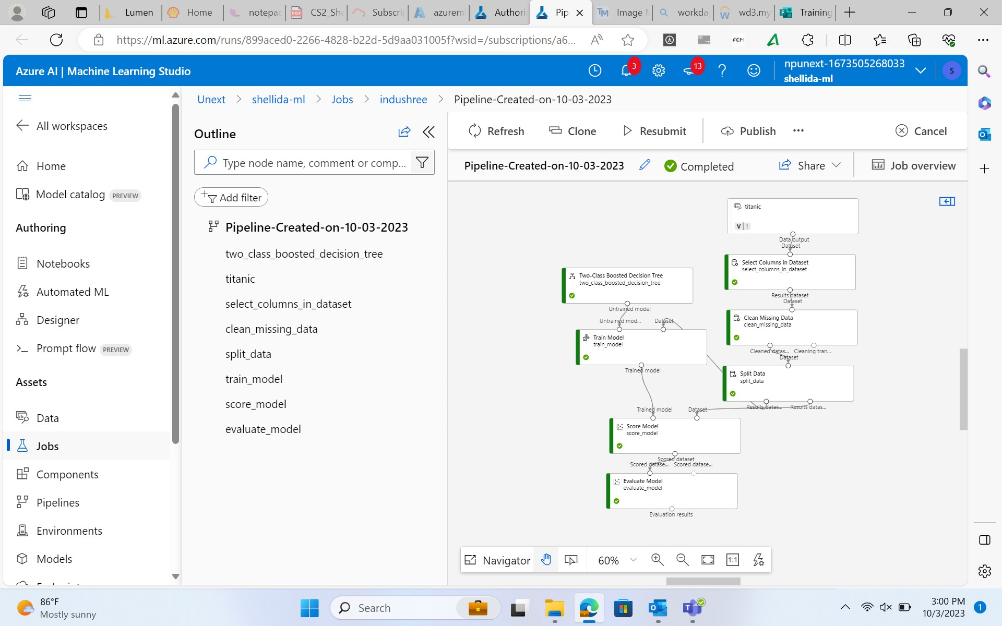
Journey PPT
(week 7)
Day-1 3/10/2023

Slide 56
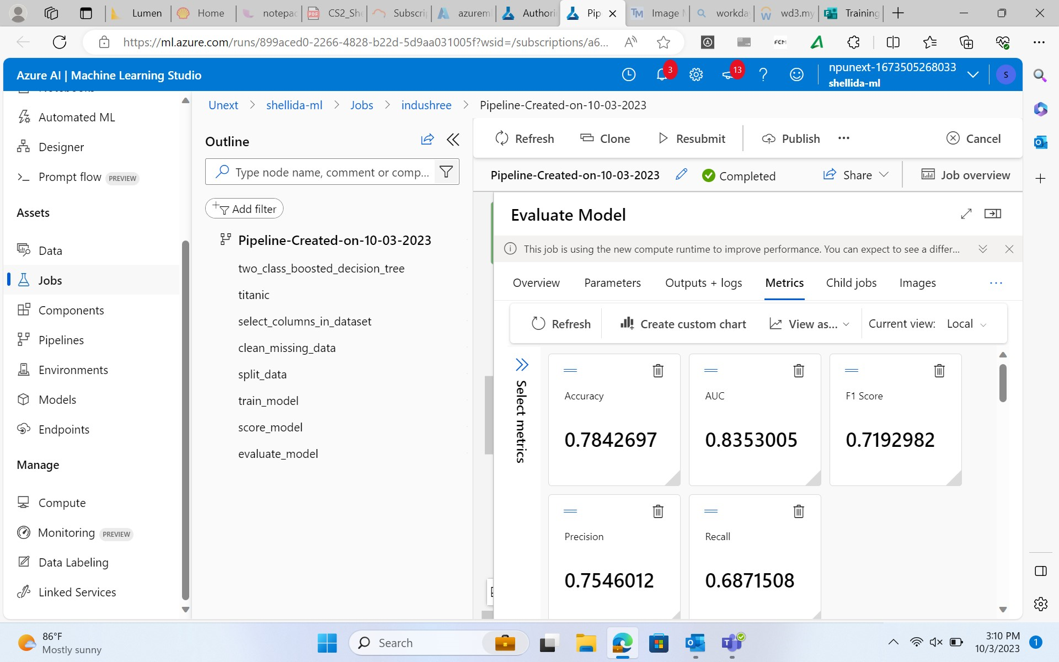
Journey PPT
(week 7) ML Studio Day-2 4/10/2023

Slide 57
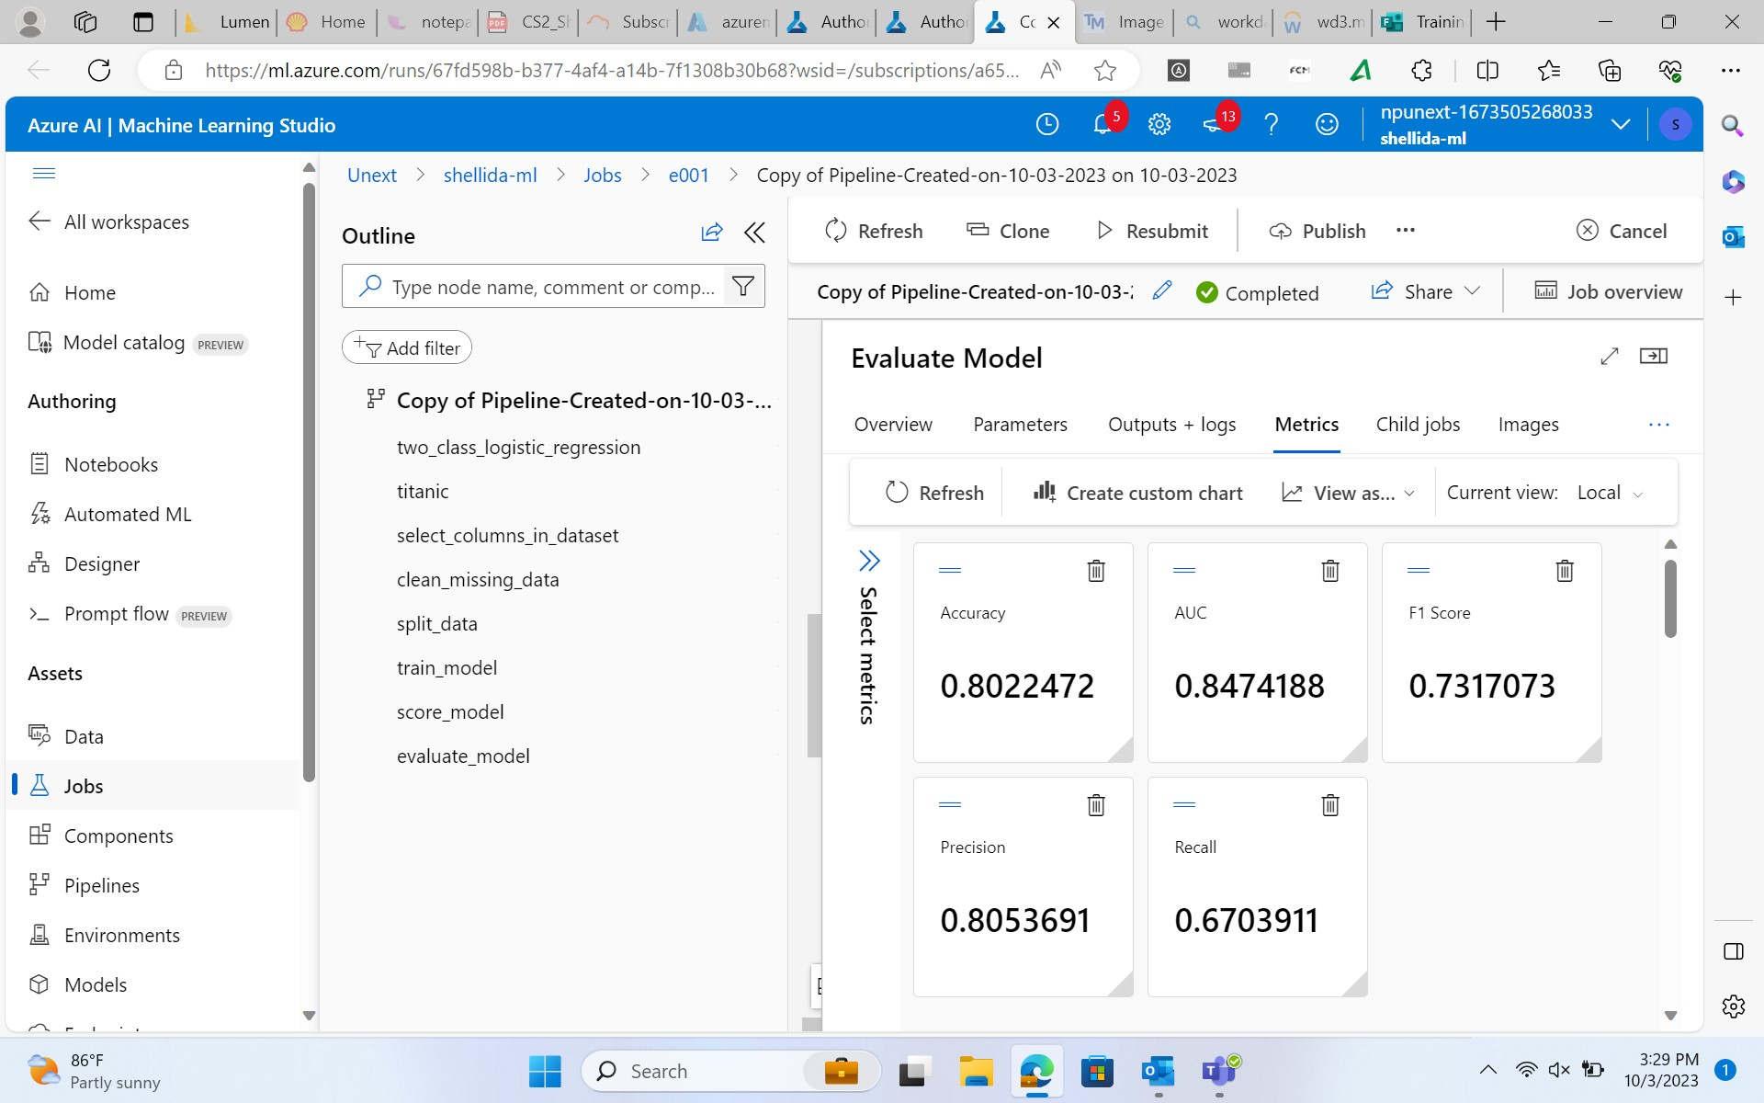
Journey PPT
(week 7)

Slide 58
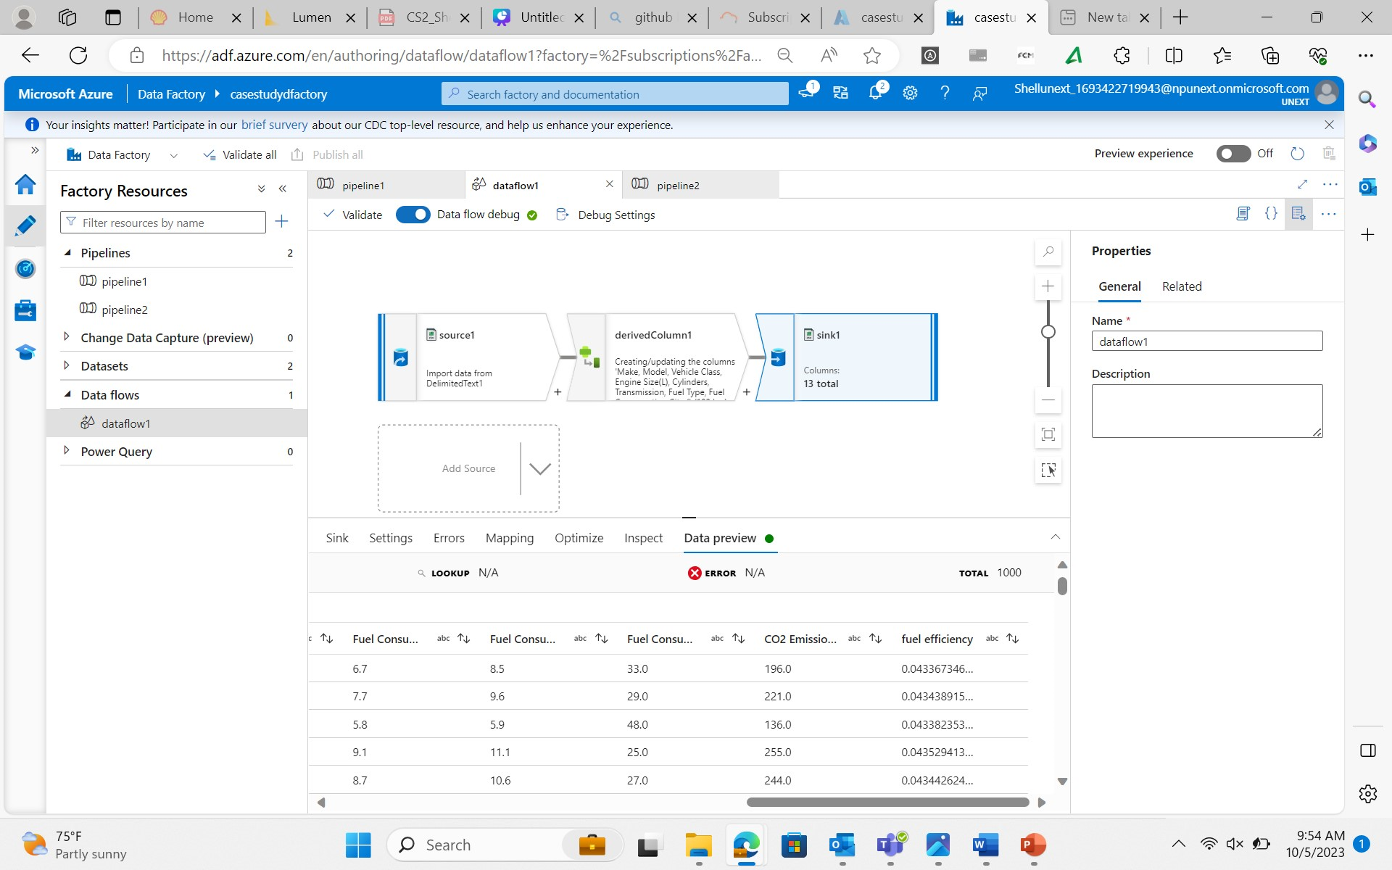
Journey PPT
(week 7)
5/10/2023
Case study

Slide 59
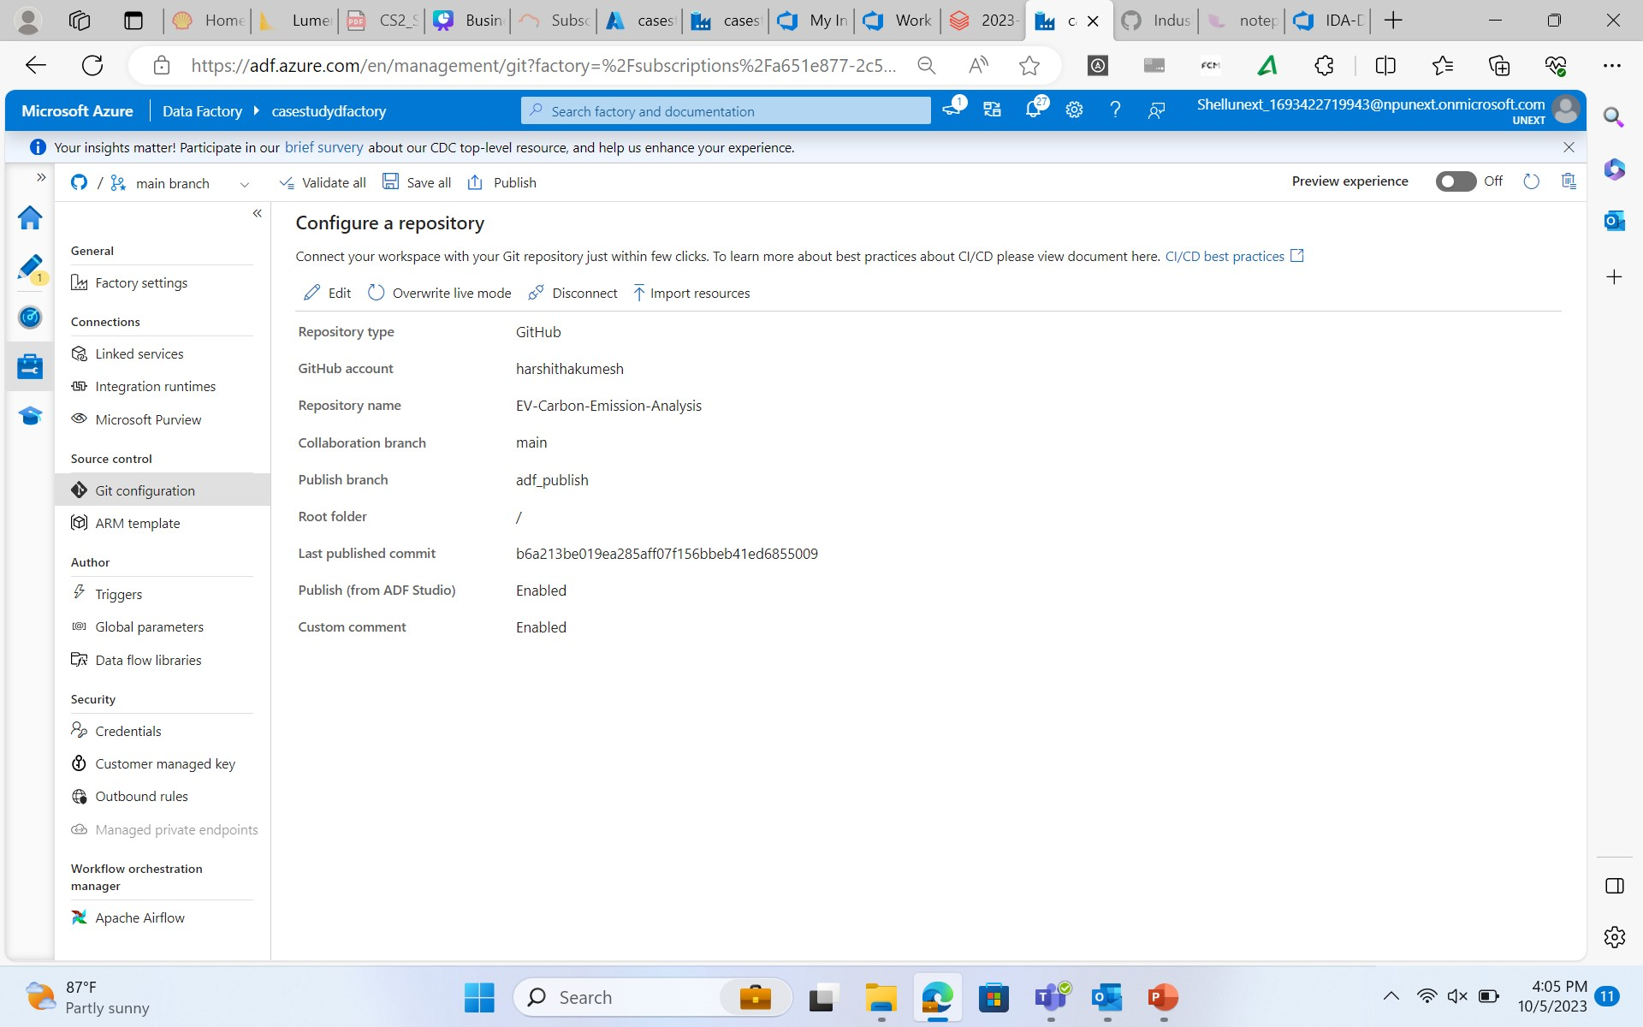
Journey PPT
(week 7)
6/10/2023
Case study

Slide 60
Indushree2001/Training (github.com)
Case Study (github collaborated repository)
harshithakumesh/EV-Carbon-Emission-Analysis (github.com)
Thank You

